Slide 1
Optimizing Converged Cisco Networks (ONT)
Module 4: Implement the DiffServ QoS Model

Slide 2

Úvod do klasifikácie a značkovania

Slide 3
Klasifikácia
Klasifikácia je proces indentifikácie a rozdelenia prevádzky do tried, spravidla na základe:
Vstupného rozhrania
Hodnoty IP precedencie
Hodnoty DSCP
Zdrojovej alebo cieľovej adresy
Aplikácie
Bez klasifikácie sa voči paketom chováme rovnako
Klasifikácia sa má realizovať čo najbližšie k zdroju dát
Notes:
Classification is the process of identifying traffic and categorizing that traffic into classes. Classification uses a traffic descriptor to categorize a packet within a specific group to define that packet. After the packet has been classified or identified, the packet is then accessible for QoS handling on the network.
Traffic descriptors that are typically used include:
Incoming interface
IP precedence
Differentiated services code point (DSCP)
Source or destination address
Application
Using classification, network administrators can partition network traffic into multiple classes of service (CoS). When traffic descriptors are used to classify traffic, the source implicitly agrees to adhere to the contracted terms and the network promises QoS. Various QoS mechanisms, such as traffic policing, traffic shaping, and queuing techniques, use the traffic descriptor of the packet (that is, the classification of the packet) to ensure adherence to that agreement.
Classification should take place at the network edge, typically in the wiring closet, within IP phones, or at network endpoints.
Cisco recommends that classification occur as close to the source of the traffic as possible.
NOTE: The term classification is interchangeable with the term packet classification.

Slide 4
Značkovanie
Značkovanie je súčasť QoS nástrojov, ktorý pridelí paketu (rámcu) istú „farbu“, ktorá ho odlišuje od iných paketov (rámcov) pre účely QoS obsluhy
Typicky použité značkovanie:
Linková vrstva:
CoS (ISL, 802.1p)
MPLS EXP (podľa RFC 5462 sa premenúva na „Traffic Class“)
Frame Relay DE (len zahadzovanie)
ATM CLP (len zahadzovanie)
Sieťová vrstva:
DSCP
IP precedencia
Notes:
Marking is related to classification. QoS classification tools categorize packets by examining the contents of the frame, cell, and packet headers; whereas marking tools allow the QoS tool to change the packet headers for easier classification.
Marking involves placing a value into one of the small number of well-defined frame, packet, or cell header fields specifically designed for QoS marking. By marking a packet, other QoS functions can perform classification based on the marked field inside a header. Marking simplifies the network's QoS design, it simplifies configuration of other QoS tools, and it reduces the overhead required by each of the other QoS tools to classify the packets.
Marking a packet or frame with its classification allows subsequent network devices to easily distinguish the marked packet or frame as belonging to a specific class. After the packets or frames are identified as belonging to a specific class, QoS mechanisms can be uniformly applied to ensure compliance with administrative QoS policies.
This slide identifies some commonly used markers at the link layer and network layers.

Slide 5
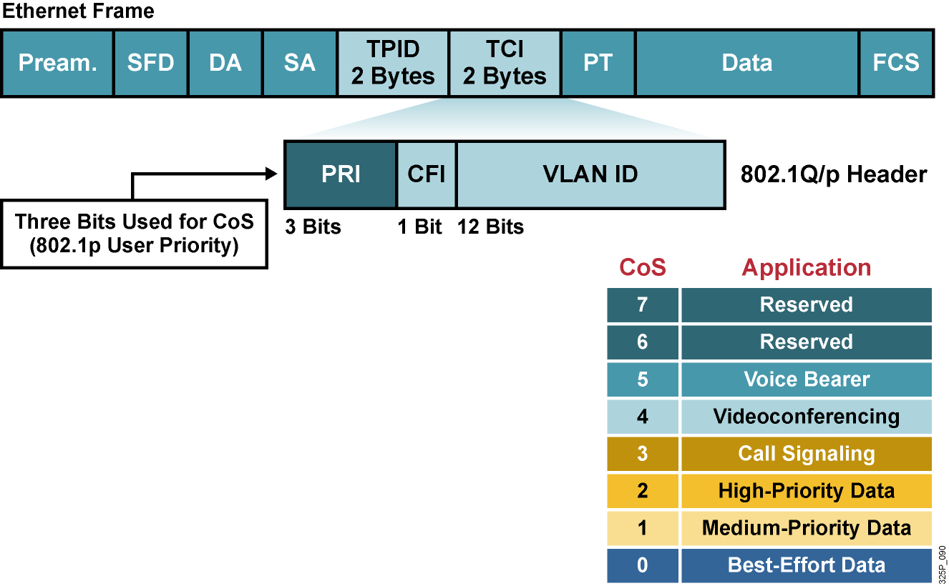
Klasifikácia a značkovanie v IEEE 802.1Q
Pole IEEE 802.1p sa nazýva CoS.
Pri 3 bitoch je možných 8 rôznych priorít
IEEE 802.1p sa zameriava na podporu QoS v LAN a nad 802.1Q
IEEE 802.1p sa zachováva len v rámci LAN, nie po celej trase
Notes:
The 802.1Q standard is an IEEE specification for implementing VLANs in Layer 2 switched networks. The 802.1Q specification defines two 2-byte fields (tag protocol identifier [TPID] and tag control information [TCI]) that are inserted within an Ethernet frame following the source address field.
The TCI field includes 3 bits that are used to identify user priority. These bits can be used to mark packets as belonging to a specific Class of Service (CoS).
The CoS marking allows a Layer 2 Ethernet frame to be marked with eight levels of priority (values 0–7). Three bits allow for 2^3 levels of classification, allowing a direct correspondence with IP version 4 (IPv4) (IP precedence) type of service (ToS) values.
One disadvantage of using CoS markings is that frames lose their CoS markings when transiting a non-802.1Q to a non-802.1p link. Trunking with 802.1Q must be enabled before the CoS field even exists. As soon as the packet encounters Layer 3 forwarding, either with a router or a Layer 3 switch, the old LAN header gets discarded and the CoS field will be lost. Therefore, a ubiquitous permanent marking should be used for network transit. This is typically accomplished by translating a CoS marking into another marker or simply using a different marking mechanism.

Slide 6
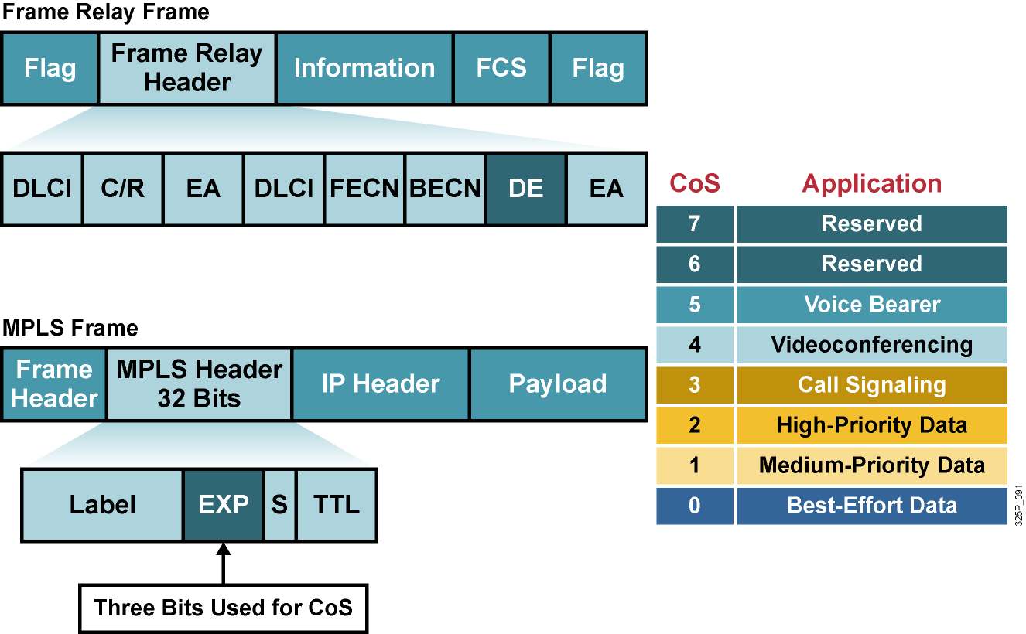
Klasifikácia a značkovanie vo WAN
Notes:
Frame Relay provides a simple set of QoS mechanisms to ensure a committed information rate (CIR): congestion notifications called forward explicit congestion notification (FECN) and backward explicit congestion notification (BECN), in addition to fragmentation of data frames when voice frames are present, as described in Frame Relay Forum standard FRF.12.
One component of Frame Relay QoS is packet discard eligibility when congestion is experienced in the network. Frame Relay will allow network traffic to be sent at a rate exceeding its CIR. The frames that exceed the committed rate can be marked as discard eligible (DE) at the ingress Frame Relay switch. If congestion occurs in the network, frames marked DE will be discarded in preference to frames that are not marked.
When a customer transmits IP packets from one site to another, the IP precedence field (the first three bits of the DSCP field in the header of an IP packet) specifies the CoS. Using IP Precedence, a network administrator can assign values from 0 (the default) to 7 to classify and prioritize types of traffic. Based on the IP precedence marking, the packet is given the desired treatment, such as guaranteed bandwidth or latency. IP Precedence is being phased out in favor of DSCP, but is supported by many applications and routers.
The MPLS experimental bits comprise a 3-bit field that you can use to map IP precedence into an MPLS label. This allows MPLS-enabled routers to perform QoS features indirectly based on the original IP Precedence field inside the IP packets encapsulated by MPLS, without the need to spend resources to look into the IP packet header and examine the IP Precedence field. If the service provider network is an MPLS network, then the IP precedence bits are copied into the MPLS Experimental (EXP) field at the edge of the network.
The MPLS EXP field allows the service provider to provide QoS without overwriting the value in the customer IP Precedence field. The IP header remains available for customer use, and the IP packet marking is not changed while the packet travels through the MPLS network

Slide 7
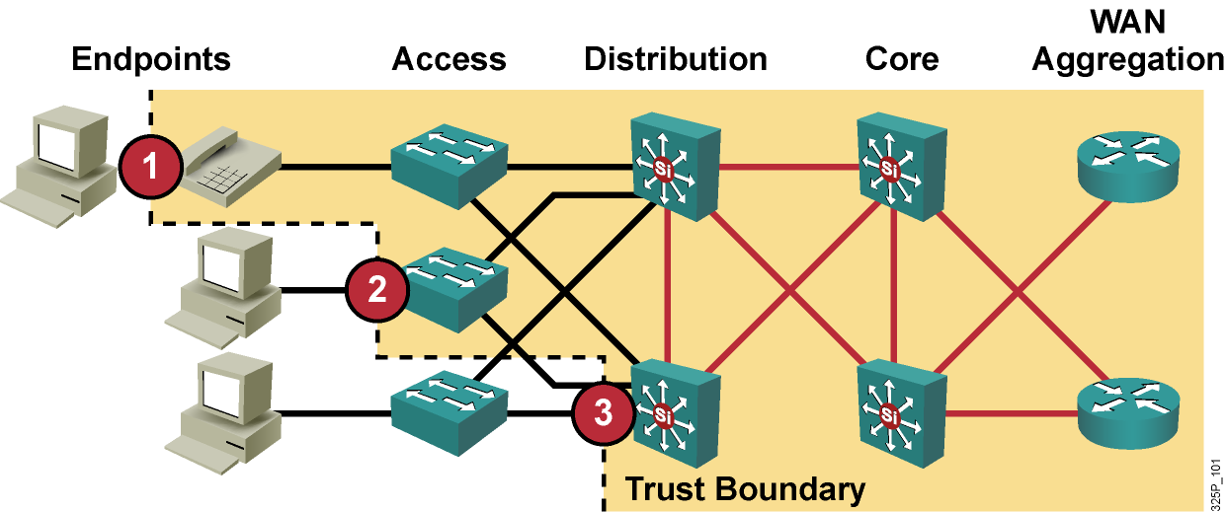
Trust Boundaries: Kde robiť klasifikáciu?
Kvôli škálovateľnosti a dôveryhodnosti by klasifikácia mala byť realizovaná čo najbližšie k okraju siete
Koncové zariadenie
Prístupová vrstva
Distribučná vrstva
Notes:
A trust boundary is the point within the network where markings such as CoS or DSCP begin to be accepted. Previously set markings are overridden as required at the trust boundary.
The location of the trust boundary depends upon the capabilities of the devices connected to the access edge of the LAN. The trust boundary must be implemented at one of three locations in a network as shown:
Endpoint or end system
Access layer
Distribution layer
Trusted endpoints have the capabilities and intelligence to mark application traffic to the appropriate CoS and/or DSCP values. Trusted endpoints also have the ability to re-mark traffic that may have been previously marked by an untrusted device.
If an endpoint is trusted, then the trust boundary should be at the endpoint. When trusted endpoints are connected to a switch port, all that is typically required is enabling the mls qos trust dscp interface command.
If the endpoint is not trusted and the switch in the wiring closet has QoS intelligence, then the trust boundary should be at the access layer—within the switch in the wiring closet.
If the endpoint is not trusted and the switch in the wiring closet does not have QoS intelligence, then the trust boundary should be at the distribution layer—within the switch or router that is aggregating traffic from the access layer.
The concept of trusting or not trusting forms the basis for the trust boundary. Ideally, classification should be done as close to the network edge as possible.

Slide 8
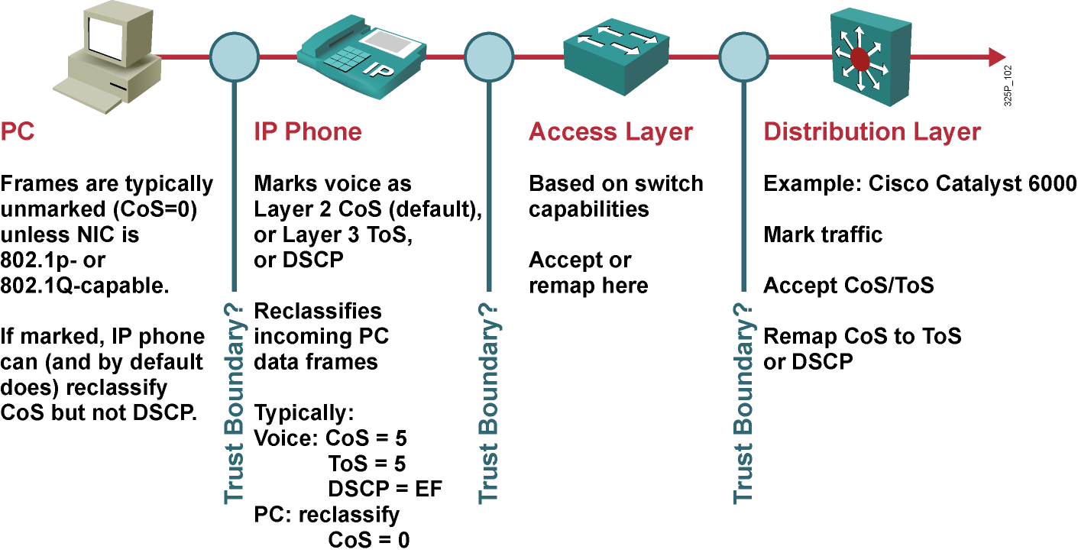
Trust Boundaries: Kde robiť značkovanie?
Notes:
This slide illustrates the challenge of selecting an appropriate place to mark a trust boundary. Classification should take place at the network edge, typically in the wiring closet or within trusted endpoints (such as servers, trusted hosts, video endpoints, or IP telephony devices).
Trusting end users and their PCs is generally not recommended because newer operating systems like Windows XP/Vista and Linux make it relatively easy to set CoS or DSCP markings on PC network interface cards (NICs). Improperly set QoS markings can affect the service levels of users within the enterprise.
IP phones are trusted devices, while PCs are not. This can be a problem when provisioning trust in a mobile environment. For example, port A is configured to trust the endpoint connected to it, which initially is an IP phone. Port B is configured not to trust the endpoint connected to it, which initially is a PC. Because of a move, these endpoints get plugged into the opposite ports. This change breaks the VoIP quality of calls made from the IP phone (now plugged into untrusted port B) and opens the network to unintentional or deliberate abuse of provisioned QoS by the PC (now plugged into the trusted port A).
Cisco switches with QoS intelligence use Cisco Discovery Protocol (CDP) to discover whether any devices plugged into its ports can be trusted. If the device can be trusted (such as a Cisco IP phone), the switch extends trust to the device dynamically. If CDP determines that the device cannot be trusted (such as a PC), the switch does not extend the trust boundary to the device.

Slide 9
Model Differentiated Services (DiffServ)
Model DiffServ sa zaoberá poskytovaním QoS nad triedami prevádzky, nie nad jednotlivými tokmi
Komplexná klasifikácia, značkovanie a vstupné úpravy prevádzky sa realizujú na okraji siete
Vo vnútri siete sa QoS pravidlá riadia už iba pridelenými značkami
Vo vnútri siete sa neudržiavajú informácie o jednotlivých tokoch, udržiavajú sa len informácie o spôsobe obsluhy jednotlivých tried prevádzky
Cieľom DiffServ je
Škálovateľnosť
Spolupráca s uzlami, ktoré ešte nepodporujú DiffServ
Možnosť postupného nasadzovania
Notes:
In contrast to integrated service (IntServ), which is a fine-grained, flow-based mechanism, differentiated service (DiffServ) is a coarse-grained, class-based mechanism for traffic management. DiffServ architecture is based on a simple model in which data packets are placed into a limited number of traffic classes, rather than differentiating network traffic based on the requirements of an individual flow.
Each traffic class can be managed differently, insuring preferential treatment for higher-priority traffic on the network.
One of the primary principles of DiffServ is that you should mark packets as close to the edge of the network as possible. It is often a difficult and time-consuming task to determine which traffic class a data packet belongs to. You want to classify the data as few times as possible. By marking the traffic at the network edge, core network devices and other devices along the forwarding path will be able to quickly determine the proper CoS to apply to a given traffic flow.
A key benefit of DiffServ is ease of scalability in comparison to IntServ.

Slide 10
Klasifikačné nástroje IP Precedence a DiffServ Code Point
Version Length
ToS
Byte
Len
ID
Offset
TTL
Proto
FCS
IP SA
IP DA
Data
IPv4 Paket
7
6
5
4
3
2
1
0
Štandard IPv4
IP Precedence
Unused
DiffServ Code Point (DSCP)
IP ECN
Rozšírenie DiffServ
IPv4: tri najvyššie bity ToS bajtu sa nazývajú IP Precedence (IPP). Ostatné bity boli niekoľkokrát predefinované (Delay, Throughput, Reliability, Monetary cost)
DiffServ: šesť najvyšších bitov ToS bajtu sa nazývajú DiffServ Code Point (DSCP). Zvyšné dva bity sa využívajú na explicitnú informáciu o zahltení (ECN). Hodnota DSCP poľa sa nazýva codepoint
Hodnoty DSCP sú spätne kompatibilné s hodnotami IP Precedence
Notes:
• IP Type of Service Byte—As Layer 2 media often changes as packets traverse from source to destination, a more ubiquitous classification would occur at Layer 3. The second byte in an IPv4 packet is the Type of Service (ToS) byte. The first three bits of the ToS byte alone are referred to as the IP Precedence (IPP) bits. These same three bits, in conjunction with the next three bits, are known collectively as the DSCP bits.
The IP Precedence bits, like 802.1p CoS bits, allow for only 8 values of marking (0-7).
IPP values 6 and 7 are generally reserved for network control traffic (such as routing).
IPP value 5 is recommended for voice.
IPP value 4 is shared by video conferencing and streaming video.
IPP value 3 is for voice-control.
IPP values 1 and 2 can be used for data applications.
IPP value 0 is the default marking value.
Many enterprises find IPP marking to be overly restrictive and limiting, favoring instead the 6-Bit/64-value DSCP marking model.

Slide 11
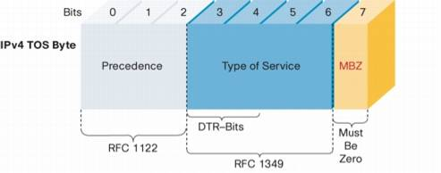
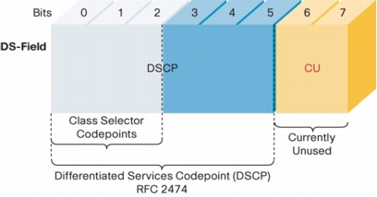
IP ToS a DS pole v IP hlavičke
Notes:
To support DiffServ, the IPv4 Type of Service (ToS) octet has been redefined from the 3-bit IP-precedence to a 6-bit DSCP field.
Prior to DiffServ, IP networks could use the Precedence field in the Type of Service (TOS) byte of the IP header to mark priority traffic.
As the TOS byte and IP precedence was not widely used, the IETF agreed to reuse the TOS byte as the DS field for DiffServ networks. In order to maintain backward compatibility with network devices that still use the Precedence field, DiffServ defines the Class Selector PHB.
The Class Selector codepoints are of the form 'xxx000'. The first three bits are the IP precedence bits. Each IP precedence value can be mapped into a DiffServ class. If a packet is received from a non-DiffServ aware router that used IP precedence markings, the DiffServ router can still understand the encoding as a Class Selector codepoint.

Slide 12
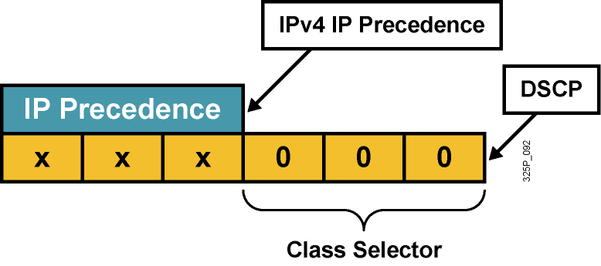
Kompatibilita IP Precedence a DSCP
Pre zachovanie kompatibility s IP Precedence (RFC 1812) boli zavedené tzv. Class Selector codepoints v tvare xyz000 s názvom CS0 až CS7
Odlišuje pravdepodobnosť včasného vybavenia paketu:
(xyz000) >= (abc000), ak xyz >= abc
Napríklad, ak má paket DSCP codepoint 011000 (CS3), má väčšiu pravdepodobnosť včasného odoslania než paket s DSCP 001000 (CS1)
Notes:
RFC 2474 replaced the ToS field with the DiffServ field, in which a range of eight values (class selector) is used for backward compatibility with IP precedence. There is no compatibility with other bits used by the ToS field.
The class selector Per Hop Behavior (PHB) was defined to provide backward compatibility for DSCP with ToS-based IP precedence.
RFC 1812 simply prioritizes packets according to the precedence value. In this sense, the PHB is defined as the probability of timely forwarding.
For example, consider a service provider offering so-called “Olympic” service classes (Gold, Silver, and Bonze) so that packets in the gold class experience lighter load, and thus have greater probability for timely forwarding, than packets assigned to the silver class. Packets with higher IP precedence should be (on average) forwarded in less time than packets with lower IP precedence.
The last 3 bits of the DSCP (bits 2 to 4) set to 0 identify a class-selector PHB.

Slide 13
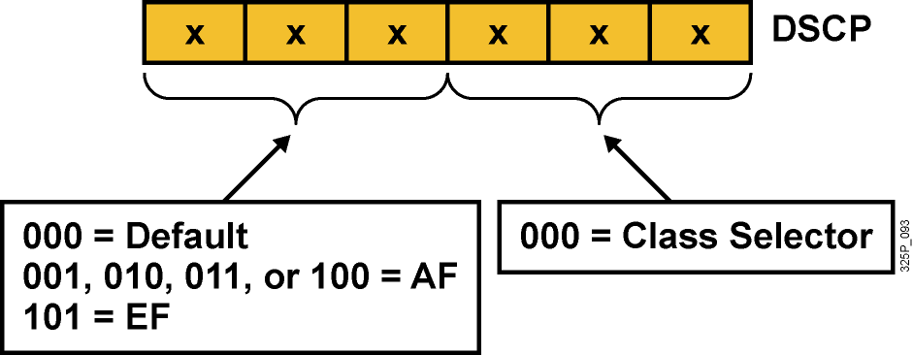
Per-Hop Behavior – PHB
PHB je spôsob obsluhy konkrétnej triedy prevádzky na danom uzle
DSCP vlastne vyberá PHB pozdĺž siete
Default PHB (FIFO, tail drop)
Class-selector PHB (IP precedence)
EF PHB (Expedited Forwarding)
AF PHB (Assured Forwarding)
Notes:
Now that packets can be marked using the DSCP, how do we provide meaningful CoS, and provide the QoS that is needed?
First, the collection of packets that have the same DSCP value (also called a codepoint) in them, and crossing in a particular direction is called a Behavior Aggregate (BA)…more about this later. Packets from multiple applications/sources could belong to the same BA.
Formally, RFC-2475 defines a Per Hop Behavior (PHB) as the externally observable forwarding behavior applied at a DS-compliant node to a DS BA. In more concrete terms, a PHB refers to the packet scheduling, queuing, policing, or shaping behavior of a node on any given packet belonging to a BA, and as configured by a Service Level Agreement (SLA) or policy.
To date, four standard PHBs are available to construct a DiffServ-enabled network and achieve coarse-grained, end-to-end CoS and QoS: Default, EF, AF and Class-selector.
PHBs are defined in terms of behavior characteristics relevant to service provisioning policies, and not in terms of particular implementation mechanisms. In general, a variety of implementation mechanisms may be suitable for implementing a particular PHB group.
The DiffServ architecture defines the DiffServ (DS) field to make per-hop behavior (PHB) decisions about packet classification and traffic conditioning functions, such as metering, marking, shaping, and policing.
The Default PHB (Defined in RFC-2474)
The default PHB specifies that a packet marked with a DSCP value (recommended) of `000000' gets the traditional best effort service from a DS-compliant node (a network node that complies to all the core DiffServ requirements). Also, if a packet arrives at a DS-compliant node and its DSCP value is not mapped to any of the other PHBs, it will get mapped to the default PHB.
Class-Selector PHBs (Defined in RFC-2474)
To preserve backward compatibility with the IP-precedence scheme, DSCP values of the form `xxx000,' where x is either 0 or 1, are defined. These codepoints are called class-selector codepoints. The PHB associated with a class-selector codepoint is a class-selector PHB. These PHBs retain almost the same forwarding behavior as nodes that implement IP-precedence based classification and forwarding. For example, packets with a DSCP value of `110000' (IP-precedence 110) have a preferential forwarding treatment (scheduling, queuing, etc.) as compared to packets with a DSCP value of `100000' (IP-precedence 100). These PHBs ensure that DS-compliant nodes can co-exist with IP-precedence aware nodes, with the exception of the DTS bits.
EF PHB (described in following slides)
AF PHB (described in following slides)

Slide 14
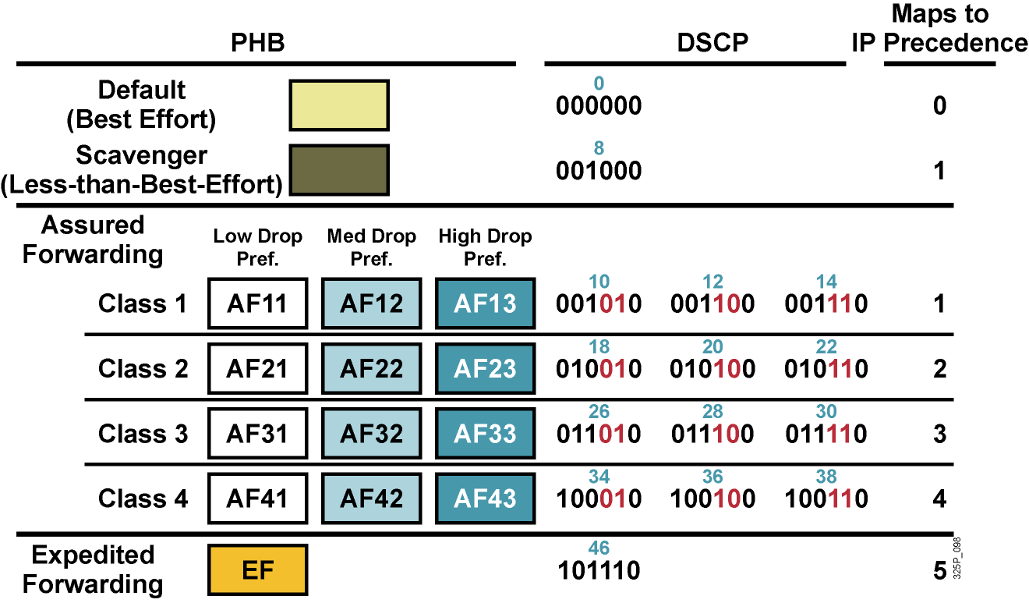
Štandardné PHB skupiny
Notes:
Standard PHBs are available to construct a DiffServ-enabled network and achieve coarse-grained, end-to-end CoS and QoS.
Default PHB (as defined in RFC 2474)
AF PHB (as defined in RFC 2597)
EF PHB (as defined in RFC 2598) class-selector PHB (as defined in RFC 2474)

Slide 15
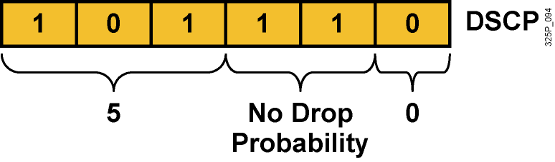
Expedited Forwarding (EF) PHB
EF PHB:
Garantuje tzv. minimum departure rate – právo prednostného odoslania
Garantuje prenosové pásmo vyhradené pre triedu prevádzky s EF
Limituje pásmo pomocou policingu – trieda s EF nemôže prekročiť garantované pridelené pásmo
DSCP codepoint 101110 (46): Pre zariadenia podporujúce len IPP je to precedencia 5:
Bity 5 až 7: 101 = 5 (rovnaké 3 bity použité pre IP Precedence)
Bity 3 a 4: 11 = Bez strát (low delay, high throughput)
Bit 2: Nastavený na 0
Notes:
The Expedited Forwarding (EF) PHB is the key ingredient in DiffServ for providing a low-loss, low-latency, low-jitter, and assured bandwidth service. Applications such as VoIP, video, and online trading programs require a robust network-treatment. EF can be implemented using priority queuing, along with rate limiting on the class (formally, a BA).
Although EF PHB when implemented in a DiffServ network provides a premium service, it should be specifically targeted toward the most critical applications, because if congestion exists, it is not possible to treat all or most traffic as high priority. EF PHB is especially suitable for applications (like VoIP) that require very low packet loss, guaranteed bandwidth, low delay and low jitter.
Packets requiring EF should be marked with DSCP binary value 101110 (46 or 0x2E).
Non-DiffServ-compliant devices regard EF DSCP value 101110 as IP precedence 5 (101). This precedence is the highest user-definable IP precedence and is typically used for delay-sensitive traffic (such as VoIP). Bits 5 to 7 of the EF DSCP value are 101, which matches IP precedence 5 and allows backward compatibility.

Slide 16
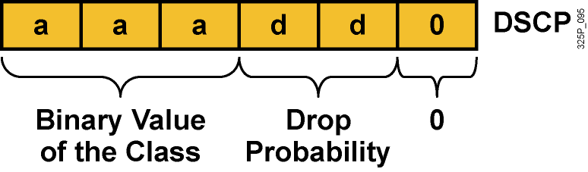
Assured Forwarding (AF) PHB
AF PHB:
Garantuje isté minimálne prenosové pásmo
Umožňuje využiť aj väčie pásmo, ak je momentálne k dispozícii
Štyri základné kategórie: AF1, AF2, AF3 a AF4
DSCP codepoint má tvar aaadd0:
aaa je binárne číslo triedy (1, 2, 3 alebo 4)
dd je pravdepodobnosť zahodenia
Notes:
The AF PHB is identified based on the following:
The AF PHB guarantees a certain amount of bandwidth to an AF class.
The AF PHB allows access to extra bandwidth, if available.
Packets requiring AF PHB should be marked with DSCP value aaadd0, where aaa is the number of the class and dd is the drop probability.
There are four standard AF classes defined: AF1, AF2, AF3, and AF4. Each class should be treated independently and should have allocated bandwidth that is based on the QoS policy.
AF PHB defines a method by which BAs can be given different forwarding assurances. For example, traffic can be divided into gold, silver, and bronze classes, with gold being allocated 50 percent of the available link bandwidth, silver 30 percent, and bronze 20 percent.

Slide 17
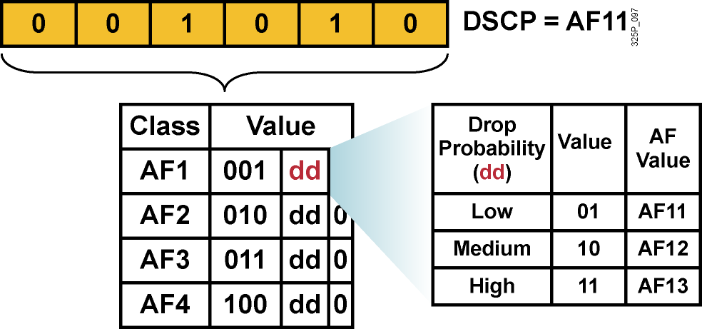
Hodnoty AF PHB
Každá AF trieda využíva 3 DSCP hodnoty
Každá AF trieda sa preposiela nezávisle od ostatných so svojou garantovanou šírkou pásma
Aby sa predišlo zahlteniu, v každej triede sa používajú techniky predchádzania zahlteniu – Weighted RED (WRED)
Ak je daná trieda AFxy, dekadickú hodnotu DSCP vypočítame ako 8x+2y
Notes:
Within each AFx class, it is possible to specify 3 drop precedence values. If there is congestion in a DS-node on a specific link, and packets of a particular AF class (for example AF1) need to be dropped, packets will be dropped such that the probability of drop creates a relationship where AFx1 <= AFx2 <= AFx3.
In other words, packets in AF13 will get dropped before packets in AF12, before packets in AF11. This concept of drop precedence is useful, for example, to penalize flows within a BA that exceed the assigned bandwidth. Packets of these flows could be re-marked by a policer to a higher drop precedence.

Slide 18
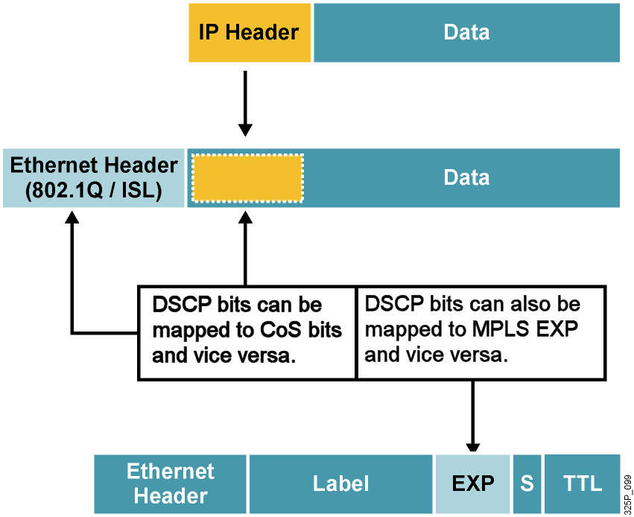
Mapovanie medzi DSCP a CoS
Notes:
Providing end-to-end QoS through an enterprise requires that CoS markings that are set at the LAN edge are mapped into QoS markings (such as IP precedence or DSCP) for transit through Campus or WAN routers. Campus and WAN routers can also map the QoS markings to new data-link headers for transit across the LAN. With the mapping, QoS can be preserved and uniformly applied across the enterprise.
Compatibility between an MPLS transport layer and network layer QoS is also achieved by mapping between MPLS EXP bits and the IP precedence or DSCP bits. A service provider can map the customer network layer QoS marking as is or change it to fit an agreed-upon SLA. The information in the MPLS EXP bits can be carried end to end in the MPLS network,

Slide 19
Vytváranie obslužných tried
Obslužné triedy sú typy prevádzky, ktoré budú vybavované rovnakým spôsobom (dostanú rovnakú QoS obsluhu)
Nie je vhodné vytvárať priveľa tried. Pre dátovú prevádzku obvykle stačí najviac 4-5 tried:
Hlasové aplikácie: VoIP
Mission-critical aplikácie: Oracle, SAP, SNA
Interaktívne aplikácie: Telnet, TN3270
Veľkoobjemové aplikácie: FTP, TFTP
Best-effort aplikácie: E-mail, web
Ostatné „smeti“: Kazaa, Yahoo, RapidShare
Do mission-critical a transakčných tried nezaraďovať viac ako tri aplikácie
Uprednostniť proaktívne pravidlá (WRED) pred reaktívnymi (policing)
Pred nasadením QoS pravidiel si nechať odsúhlasiť rozdelenie prevádzky na jednotlivé priority a ich pomery od vedenia spoločnosti
Notes:
One key element of defining QoS service classes is to understand the basic quality needs of network applications. It is essential that applications be given QoS treatment in line with their needs. For example, improperly specifying voice traffic into a service class with guaranteed bandwidth but without a guaranteed low latency (delay) would not meet the needs of the voice traffic.
While it is important to fully understand network application requirements, it is equally important not to overprovision or overdesign the administrative policy. An administrative policy should be proactive in nature and require as few service classes as necessary. One good rule is to limit the number of service classes to no more than four or five.
The QoS requirements of these applications can be met with a few well-designed service classes. The more service classes implemented in support of an administrative QoS policy, the more complex the QoS implementation will be. This complexity also extends to support and troubleshooting.
It is also important that the highest-priority classes be reserved for a select few applications. Marking 90 percent of network traffic as high priority will render most administrative QoS policies useless.

Slide 20
Koľko tried treba?
4/5 Class Model
8 Class Model
11 Class Model
Realtime
Voice
Voice
Interactive-Video
Video
Streaming Video
Call Signaling
Call Signaling
Call Signaling
Critical Data
Network Control
IP Routing
Network Management
Critical Data
Mission-Critical Data
Transactional Data
Bulk Data
Bulk Data
Best Effort
Best Effort
Best Effort
Scavenger
Scavenger
Scavenger
Čas
Notes:
Many enterprises aren’t ready to deploy a complex 11-Class Model, or may never have the need for 11 classes of service.
5-Classes is the recommended model for provisioning QoS for Voice, Video and Data.
Some of these classes can be gradually split into more granular classes, as shown in the diagram, as needed by the network.

Slide 21
Classification and Marking Design Odporúčania pre QoS Baseline Marking
Application
L3 Classification
L2
IPP
PHB
DSCP
CoS
Routing
6
CS6
48
6
Voice
5
EF
46
5
Video Conferencing
4
AF41
34
4
Streaming Video
4
CS4
32
4
Mission-Critical Data
3
AF31*
26
3
Call Signaling
3
CS3*
24
3
Transactional Data
2
AF21
18
2
Network Management
2
CS2
16
2
Bulk Data
1
AF11
10
1
Best Effort
0
0
0
0
Scavenger
1
CS1
8
1
Notes:
Cisco has adopted a new initiative called the “QoS Baseline.” The QoS Baseline is a strategic document designed to unify QoS within Cisco, from enterprise to service provider and from engineering to marketing. The QoS Baseline was written by Cisco's most qualified QoS experts.
The QoS Baseline specifies 11 traffic classes within the enterprise. An important note is that the QoS Baseline is not dictating that every enterprise deploy 11 different traffic classes immediately, but rather it is considering enterprise QoS needs of not only today, but also the foreseeable future. Even if an enterprise needs to provision for only a handful of these 11 classes today, following QoS Baseline recommendations will enable them to leave options open for smoothly provisioning additional traffic classes in the future.
Note: The QoS Baseline recommends marking Call-Signaling to CS3. Currently, however, all Cisco IP Telephony products mark Call-Signaling to AF31. A marking migration from AF31 to CS3 is planned within Cisco, but in the interim it is recommended that both AF31 and CS3 be reserved for Call-Signaling and that Locally-Defined Mission-Critical data applications be marked to DSCP 25. Upon completion of the migration, the QoS Baseline marking recommendations of CS3 for Call-Signaling and AF31 for Locally-Defined Mission-Critical applications should be used. These marking recommendations are more inline with RFC 2597 and RFC 2474.

Slide 22
Module 4: Implement the DiffServ QoS Model
Lesson 4.2: Using NBAR for Classification

Slide 23
Network-Based Application Recognition
NBAR je inteligentný klasifikačný aparát použiteľný s QoS, ktorý:
Rozpoznáva a umožňuje klasifikovať moderné client-server a webové aplikácie
Identifikuje druhy prevádzky na sieti
V reálnom čase analyzuje zloženie prevádzky podľa jednotlivých aplikácií
Class-mapy definované pomocou NBAR možno použiť ako akékoľvek iné
Funkcie NBAR:
Identifikuje aplikácie a protokoly (Layer 4–7)
Realizuje „objavenie“ (discovery) protokolov
Poskytuje štatistiky o prevádzke
Podpora pre rozpoznanie nových aplikácií sa do NBAR pridáva pomocou tzv. PDLM modulov
Môj program ide pomaly!
Citrix 25%
Netshow 15%
Fasttrack 10%
FTP 30%
HTTP 20%
Príklad využitia linky
Notes:
Network-Based Application Recognition (NBAR) is a classification and protocol discovery feature of Cisco IOS software that recognizes a wide variety of applications, including web-based applications and client/server applications that dynamically assign TCP or UDP port numbers.
After NBAR recognizes an application, the network can invoke specific services for that particular application. These features include the ability to guarantee bandwidth to critical applications, limit bandwidth to other applications, drop selective packets to avoid congestion, and mark packets appropriately so that the network and the service provider's network can provide QoS from end to end.
NBAR works with QoS features. NBAR ensures that network bandwidth is used efficiently by classifying packets and then applying QoS to the classified traffic.

Slide 24
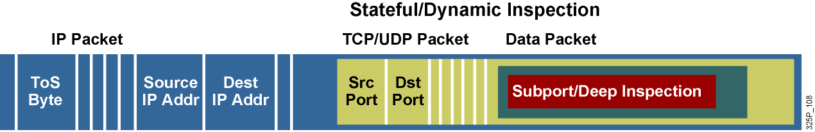
Podpora aplikácií v NBAR
NBAR dokáže rozpoznať aplikácie, ktoré využívajú:
Statické TCP či UDP porty
Protokoly, ktoré nevyužívajú UDP alebo TCP
Dynamicky pridelené TCP a UDP porty, ktoré boli dohodnuté počas vytvorenia spojenia (vyžaduje si tzv. stateful inspection)
Hĺbková klasifikácia na základe obsahu paketov
Notes:
NBAR can classify application traffic by looking beyond the TCP/UDP port numbers of a packet. This is subport classification. NBAR looks into the TCP/UDP payload itself and classifies packets on content within the payload such as transaction identifier, message type, or other similar data.
NBAR recognizes packets belonging to different types of applications:
Static applications establish sessions to well-known TCP or UDP destination port numbers. Such applications, such as Simple Mail Transfer Protocol (SMTP), could also be classified by using access control lists (ACLs).
Some non-IP protocols, such as Novell Internetwork Packet Exchange (IPX), can also be recognized by NBAR.
Dynamic applications use multiple sessions that use dynamic TCP or UDP port numbers. Typically, there is a control session to a well-known port number, and the other sessions are established to destination port numbers negotiated through the control sessions, such as those used with FTP. NBAR inspects the port number exchange through the control session.
NBAR also has the capability to inspect some applications for other information and to classify based on that information. For example, NBAR can classify HTTP sessions based on the requested URL, including MIME type or host name.

Slide 25
Packet Description Language Module
PDLM je súbor, ktorý obsahuje popis protokolu pre jeho rozpoznanie pomocou NBAR
PDLM sa ukladá do FLASH
PDLM je možné pridať za behu bez potreby reštartovať router
PDLM môžu takisto zdokonaliť rozpoznanie už podporovaných protokolov
PDLM sú vytvárané iba spoločnosťou Cisco (nie administrátorom)
router(config)#
ip nbar pdlm pdlm-name
Aktivuje externé PDLM, meno je v URL formáte, napr.: flash://citrix.pdlm
router(config)#
ip nbar port-map protocol-name [tcp | udp] port-number
Definuje porty, na ktorých sa daný protokol má hľadať (najviac 16 portov)
Je možné predefinovať typické porty pre protokoly, alebo k existujúcemu typickému portu pridať nový
Notes:
NBAR supports dynamic upgrades without having to change the Cisco IOS version or restart a router.
Packet Description Language Modules (PDLM) contain the rules that are used by NBAR to recognize an application by matching text patterns in data packets, and they can be used to bring new or changed functionality to NBAR.
An external PDLM can be loaded at run time to extend the NBAR list of recognized protocols. Use PDLMs to enhance an existing protocol-recognition capability. PDLMs allow NBAR to recognize new protocols without requiring a new Cisco IOS image or a router reload.

Slide 26
Mapovanie protokolov na porty v NBAR
router#
show ip nbar port-map [protocol-name]
Zobrazí súčasné priradenie portov a protokolov
Router# show ip nbar port-map
port-map bgp udp 179
port-map bgp tcp 179
port-map cuseeme udp 7648 7649
port-map cuseeme tcp 7648 7649
port-map dhcp udp 67 68
port-map dhcp tcp 67 68
port-map dns udp 53
port-map dns tcp 53
Notes:
Use the show ip nbar port-map command to display the current protocol-to-port mappings in use by NBAR. The protocol-name argument can also be used to limit the display to a specific protocol. Figure [3] shows the command syntax.
After the ip nbar port-map command has been used, the show ip nbar port-map command displays the ports assigned by the administrator to the protocol. If no ip nbar port-map command has been used, the show ip nbar port-map command displays the default ports.

Slide 27
NBAR Protocol Discovery
Funkcia „NBAR Protocol Discovery“ analyzuje existujúcu sieťovú prevádzku v reálnom čase
Identifikuje používané protokoly na sieti
Poskytuje obojsmerné štatistiky o protokoloch na rozhraniach a o používaných protokoloch vôbec
Poskytuje dôležitý monitorovací nástroj:
Generuje prehľady o existujúcej prevádzke v reálnom čase
Informuje o rozdelení prevádzky medzi jednotlivé aplikácie na kľúčových miestach siete
router(config-if)#
ip nbar protocol-discovery
Aktivuje NBAR Protocol Discovery na rozhraní (CEF musí byť vopred aktívne)
Na rozhraní môže, ale nemusí byť použitá service policy (NBAR nezávisí na QoS)
router#
show ip nbar protocol-discovery
Zobrazí získané štatistiky o prevádzke na rozhraniach, kde je NBAR aktivované
Notes:
To develop and apply QoS policies, NBAR includes a protocol-discovery feature that provides an easy way to discover application protocols that are transiting an interface. The feature discovers any protocol traffic supported by NBAR.
NBAR Protocol Discovery captures key statistics associated with each protocol in a network (packet counts, byte counts, and bit rates) on a per interface basis. These statistics define traffic classes and QoS policies for each traffic class. GUI based management tools can graphically display this information, by polling Simple Network Management Protocol (SNMP) statistics from the NBAR Protocol Discovery (PD) Management Information Base (MIB).
NBAR Protocol Discovery can be applied to interfaces and can be used to monitor both input and output traffic. In addition, it shows the mix of applications currently running on the network. This information helps in defining QoS classes and policies, such as how much bandwidth to provide to mission-critical applications, and in determining which protocols should be policed.

Slide 28
Príklad získaných štatistík NBAR
router# show ip nbar protocol-discovery
Ethernet0/0
Input Output
Protocol Packet Count Packet Count
Byte Count Byte Count
5 minute bit rate (bps) 5 minute bit rate (bps)
---------- ------------------------ ------------------------
realaudio 2911 3040
1678304 198406
19000 1000
http 19624 13506
14050949 2017293
0 0
<output omitted>
Notes:
NBAR Protocol Discovery can monitor both input and output traffic and can be applied with or without a service policy enabled. NBAR Protocol Discovery gathers statistics for packets switched to output interfaces. These statistics are not necessarily for packets that exited the router on the output interfaces, because packets might have been dropped after switching for various reasons (policing at the output interface, ACLs, or queue drops).
The example here displays partial output of the show ip nbar protocol-discovery command for an Ethernet interface.

Slide 29
Využitie NBAR v QoS nástrojoch
Postup konfigurácie:
Ak je to potrebné, aktivovať externé PDLM moduly
Aktivovať NBAR Protocol Discovery
Osobne si myslím, že toto tvrdenie nie je pravdivé
Vytvoriť class-map, v ktorej využijeme NBAR
Vytvoriť príslušnú policy-map
Aplikovať policy-map na rozhranie
router(config-cmap)#
match [not] protocol meno-protokolu
Notes:
The ability of NBAR to classify traffic by protocol and then apply QoS to that traffic uses the MQC class map match criteria. The following steps, are required to successfully deploy NBAR for static protocols:
Enable NBAR Protocol Discovery.
Configure a traffic class.
Configure a traffic policy.
Attach the traffic policy to an interface.
Enable PDLM if needed.

Slide 30
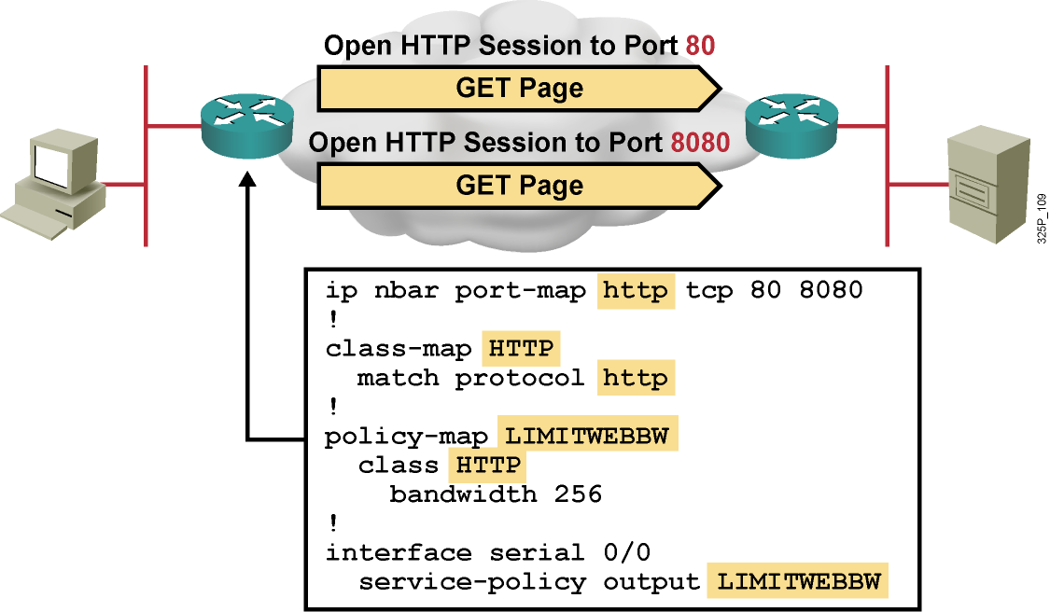
Príklad využitia NBAR
HTTP bežne beží na TCP porte 80, avšak v tomto príklade je identifikovaný aj na porte 8080 pomocou pridania príkazu ip nbar port-map
Ak sa má protokol hľadať aj na typickom porte, treba ho uviesť
Notes:
This is an example of using the ip nbar port-map command. HTTP is often used on other port numbers. The example shows the usage of the ip nbar port-map command to also enable HTTP recognition on TCP port 8080.
The NBAR port map is configured for HTTP for TCP ports 80 and 8080.
The class map called “HTTP” is used to match the HTTP protocol. The policy map called “LIMITWEBB” will use the class map HTTP and set the bandwidth for HTTP traffic to 256 kbps.
The policy map is then applied as a service policy for outbound traffic on serial0/0.

Slide 31
Regulárne výrazy
Znak | Význam
* | Vracia zhodu s hocijakou, i prázdnou skupinou znakov *cia = cia, funkcia, relacia, ambivalencia, insuficiencia, …
? | Vracia zhodu s ľubovoľným jedným znakom c?slo = caslo, cbslo, ccslo, …
| | Vracia zhodu s jedným zo znakov v danej alternatíve pa|eter = pater, peter
(|) | Vracia zhodu s jednou zo skupín znakov v danej alternatíve picture.(gif|jpg) = picture.gif, picture.jpg
[ ] | Vracia zhodu s jedným zo znakov v danom intervale znakov alebo so špeciálnym znakom [0-9] = 0, 1, 2, 3, 4, 5, 6, 7, 8, 9 [prst] = p, r, s, t [a-e] = a, b, c, d, e [*] = * (znak) [[] = [ (znak)
Notes:
The table lists various regular expressions and their description.
The following example configures NBAR to match all FastTrack traffic:
match protocol fasttrack file-transfer "*"
In the next example, all FastTrack files that have the .mpeg extension will be classified into class map nbar.
class-map match-all nbar
match protocol fasttrack file-transfer "*.mpeg"
The following example configures NBAR to match FastTrack traffic that contains the string “cisco”:
match protocol fasttrack file-transfer "*cisco*"

Slide 32
Pokročilé možnosti NBAR klasifikácie pre HTTP
router(config-cmap)#
match protocol http url url-string
Hľadá HTTP GET pakety, v ktorých sa objavuje zadané URL, a potom vracia zhodu na všetky ďalšie pakety, ktoré súvisia s danou jednou HTTP konverzáciou s týmto hostiteľom
url-string má obsahovať iba cestu za menom servera alebo jej podreťazec (napr. http://www.cisco.com/go/certifications)
url-string môže obsahovať regulárne výrazy
router(config-cmap)#
match protocol http host hostname-string
router(config-cmap)#
Hľadá v HTTP pakete pole „Host“, ktoré obsahuje daný (pod)reťazec a vracia zhodu na všetky ďalšie pakety, ktoré súvisia s danou jednou HTTP konverzáciou s týmto hostiteľom
hostname-string môže obsahovať regulárne výrazy
Notes:
NBAR has enhanced classification capabilities for HTTP. It can classify packets belonging to HTTP flows based on the following:
The URL portion after the host name, which appears in the GET request of the HTTP session
The host name specified in the GET request
The following example classifies, within the class map called “class1,” HTTP packets based on any URL containing the string “whatsnew/latest” followed by zero or more characters:
class-map class1
match protocol http url whatsnew/latest*
The next example classifies, within the class map called “class2,” packets based on any host name containing the string “cisco” followed by zero or more characters:
class-map class2
match protocol http host cisco*

Slide 33
Pokročilé možnosti NBAR klasifikácie pre HTTP, FastTrack a Gnutella toky
router(config-cmap)#
match protocol http mime MIME-type
Hľadá HTTP paket, v ktorom sa uvádza daný MIME typ obsahu, a vracia zhodu na všetky ďalšie pakety, ktoré súvisia s danou jednou HTTP konverzáciou s týmto hostiteľom
MIME-type môže obsahovať regulárne výrazy
router(config-cmap)#
match protocol { fasttrack | gnutella } file-transfer regulárny-výraz
Stavový mechanizmus na identifikáciu celého radu peer-to-peer aplikácií pre zdieľanie súborov
regulárny-výraz popisuje tvar mena súboru, prenos ktorého sa sleduje. Znak „*“ označuje hociaký súbor
Notes:
NBAR supports a wide range of network protocols, including the stateful protocols that were difficult to classify before. Stateful protocols such as HTTP or FastTrack applications need special configuration to use the NBAR feature.
NBAR offers the ability to match packets containing a specified MIME type.
The following example classifies, within the class map called “class3,” packets based on the JPEG MIME type:
class-map class3
match protocol http mime "*jpeg"
Applications that use the FastTrack peer-to-peer protocol include Kazaa, Grokster, and Morpheus (although newer versions of Morpheus use Gnutella).
A regular expression is used to identify specific FastTrack traffic. For instance, entering “cisco” as the regular expression would classify the FastTrack traffic containing the string “cisco” as a match for the traffic policy.

Slide 34
Peer-to-peer protokoly a NBAR
Protokol FastTrack používajú:
KaZaA
Grokster
iMesh
Morpheus (do roku 2002)
Protokol Gnutella používajú:
BearShare
Gnewtellium
Gnucleus
Gtk-Gnutella
Jtella
LimeWire
Morpheus (novší)
Mutella
Phex
Qtella
Swapper
XoloX
XCache

Slide 35
Pokročilé možnosti NBAR klasifikácie pre RTP
router(config-cmap)#
match protocol rtp [audio | video | payload-type payload-string]
Hľadá RTP toky zadaného typu
Typ identifikuje na základe RTP poľa „Payload Type“
audio: Hodnota Payload Type je medzi 0 až 23
video: Hodnota Payload Type je medzi 24 až 33
payload-type: Špecifická hodnota Payload Type, je možné uviesť i viac hodnôt oddelených čiarkou (postupnosti) alebo pomlčkou (rozsahy)
Notes:
Real-Time Transport Protocol (RTP) consists of a data part and a control part. The control part is called Real-Time Transport Control Protocol (RTCP). It is important to note that the NBAR RTP payload classification feature does not identify RTCP packets and that RTCP packets run on odd-numbered ports, while RTP packets run on even-numbered ports.
The data part of RTP is a thin protocol providing support for applications with real-time properties (such as continuous media [audio and video]), which includes timing reconstruction, loss detection, and security and content identification. The RTP payload type is the data transported by RTP in a packet (for example, audio samples or compressed video data).
NBAR RTP payload classification not only allows you to statefully identify real-time audio and video traffic, but it also can differentiate on the basis of audio and video codecs to provide more granular QoS. The RTP payload classification feature looks deep into the RTP header to classify RTP packets.

Slide 36
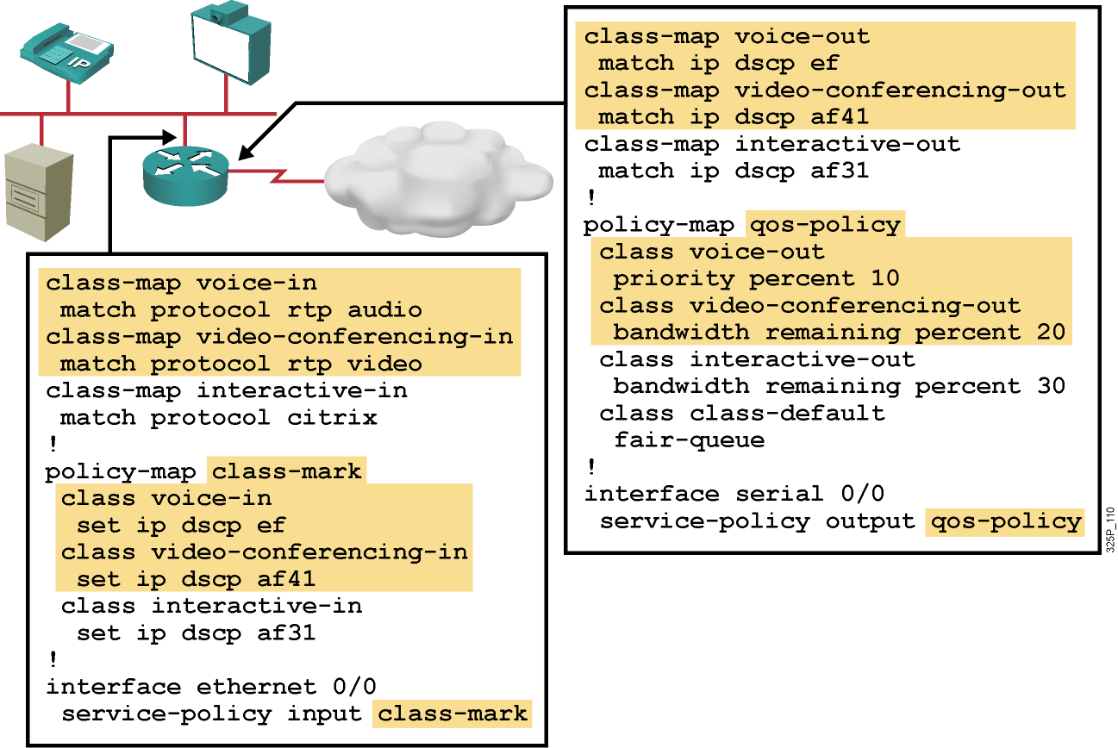
Príklad klasifikácie RTP pomocou NBAR
Notes:
The example shows a simple classification of RTP sessions, both on the input interface and on the output interface of the router.
On the input interface, three class maps have been created: voice-in, videoconferencing-in, and interactive-in. The voice-in class map will match the RTP audio protocol, the videoconferencing-in class map will match the RTP video protocol, and the interactive-in class map will match the Citrix protocol.
The class-mark policy map will then do the following:
If the packet matches the voice-in class map, the packet differentiated services code point (DSCP) field will be set to Expedited Forwarding (EF). If the packet matches the videoconferencing-in class map, the packet DSCP field will be set to Assured Forwarding (AF) 41. If the packet matches the interactive-in class map, the DSCP field will be set to AF 31.
The class-mark policy map is applied to the input interface, Ethernet 0/0.
On the output interface, three class maps have been created: voice-out, videoconferencing-out, and interactive-out. The voice-out class map will match the DSCP field EF. The videoconferencing-out class map will match the DSCP field AF 41. The interactive-out class map will match the DSCP field AF 31.
As shown in the figure, the qos-policy policy map will then do the following:
If the packet matches the voice-out class map, the packet priority will be set to 10 percent of the bandwidth. If the packet matches the videoconferencing-out class map, the packet priority will be set to 20 percent of the bandwidth. If the packet matches the interactive-out class map, the packet priority will be set to 30 percent of the bandwidth. All other packets will be classified as class-default and fair queuing will be performed on them.
The class-mark policy map is applied to the output interface, serial 0/0.

Slide 37
Module 4: Implement the DiffServ QoS Model
Lesson 4.3: Introducing Queuing Implementations

Slide 38
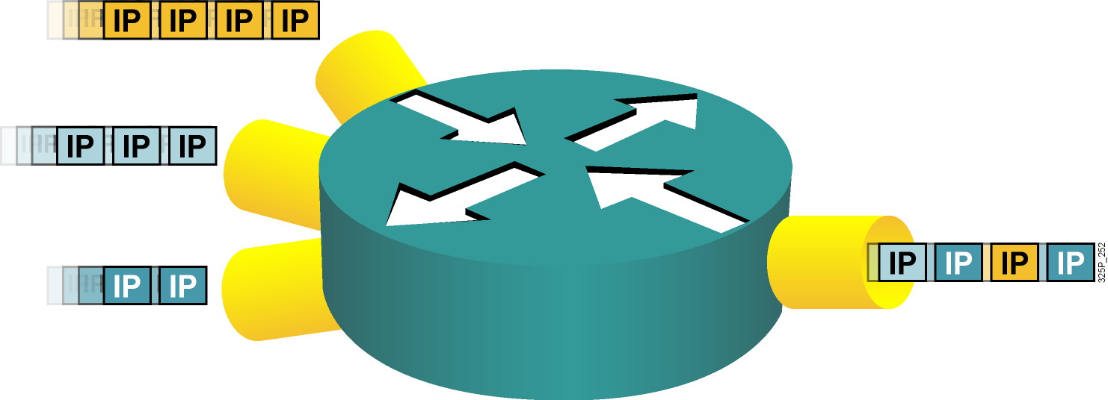
Zahltenie a ukladanie paketov do frontov
Zahltenie môže nastať na akomkoľvek mieste v sieti, kde sa realizuje agregácia alebo kde je spád v poskytovanej rýchlosti
Ukladanie do frontov riadi zahltenie poskytovaním garancií na šírku pásma a oneskorenie
Notes:
Congestion can occur anywhere within a network where speed mismatches (for example, a 1000-Mbps link feeding a 100-Mbps link), aggregation (for example, multiple 100-Mbps links feeding an upstream 100-Mbps link), or confluence (the joining of two or more traffic streams) accrue.
Congestion-management features control the congestion when it occurs. One way that network elements handle an overflow of arriving traffic is to use a queuing algorithm to sort the traffic and then determine some method of prioritizing it onto an output link. Each queuing algorithm was designed to solve a specific network traffic problem and has a particular effect on network performance.
Many algorithms have been designed to serve different needs. A well-designed queuing algorithm provides some bandwidth and delay guarantees to priority traffic.

Slide 39
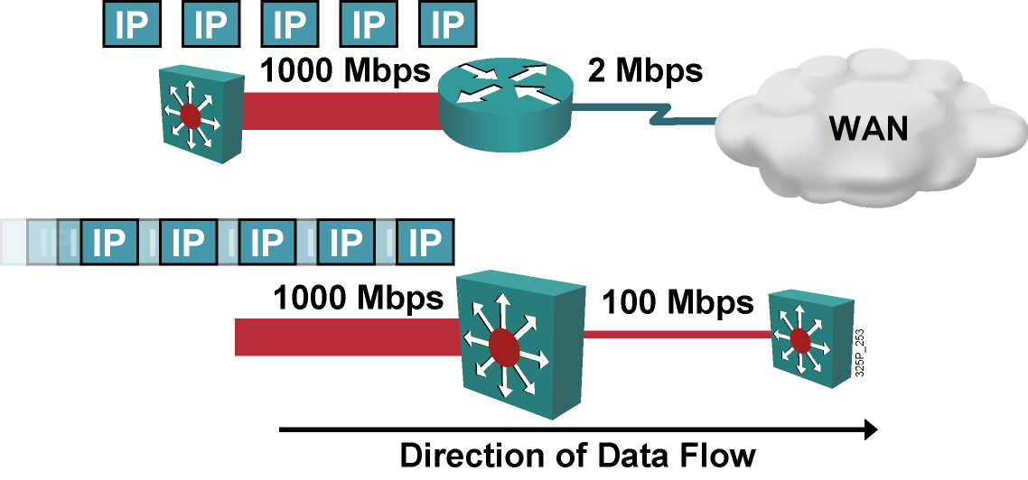
Neprispôsobenie rýchlosti
Neprispôsobenie rýchlosti je najbežnejší dôvod zahltenia
Zahltenie je pri prestupe z LAN do WAN potenciálne trvalé
Zahltenie je pri prestupe medzi dvomi LAN potenciálne dočasné
Notes:
Speed mismatches are the most common reason for congestion. It is possible to have persistent congestion when traffic is moving from a LAN to a WAN, such as when traffic moves from a high-speed LAN environment (100 or 1000 Mbps) to lower-speed WAN links (1 or 2 Mbps). Speed mismatches are also common in LAN-to-LAN environments when, for example, a 1000-Mbps link feeds into a 100-Mbps link, but in those cases they are transient.

Slide 40
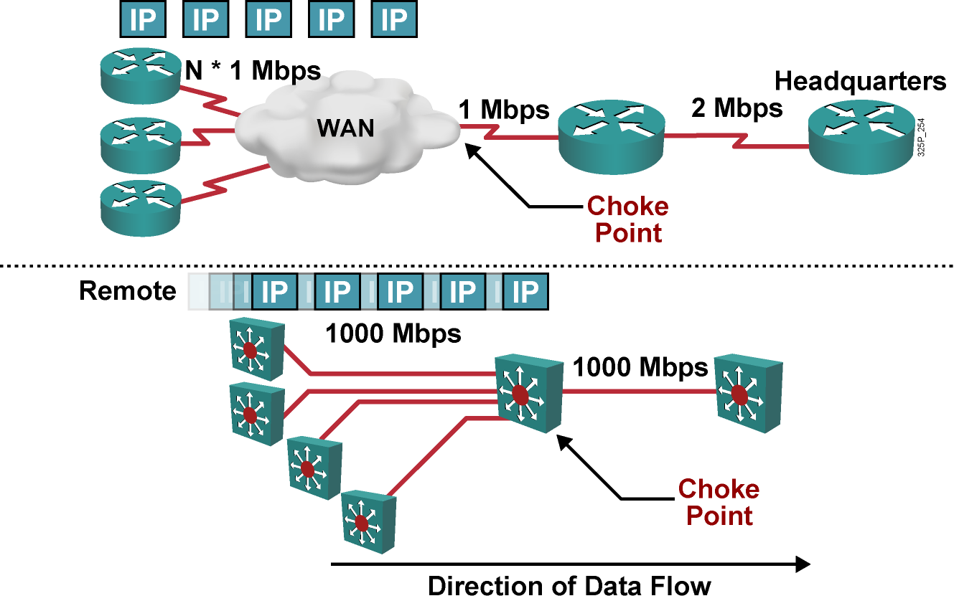
Agregácia
Notes:
The second most common source of congestion is points of aggregation in a network.
Typical points of aggregation occur in WANs when multiple remote sites feed into a central site.
In a LAN environment, congestion resulting from aggregation often occurs at the distribution layer of networks where the access layer devices feed traffic to the distribution layer switches.

Slide 41
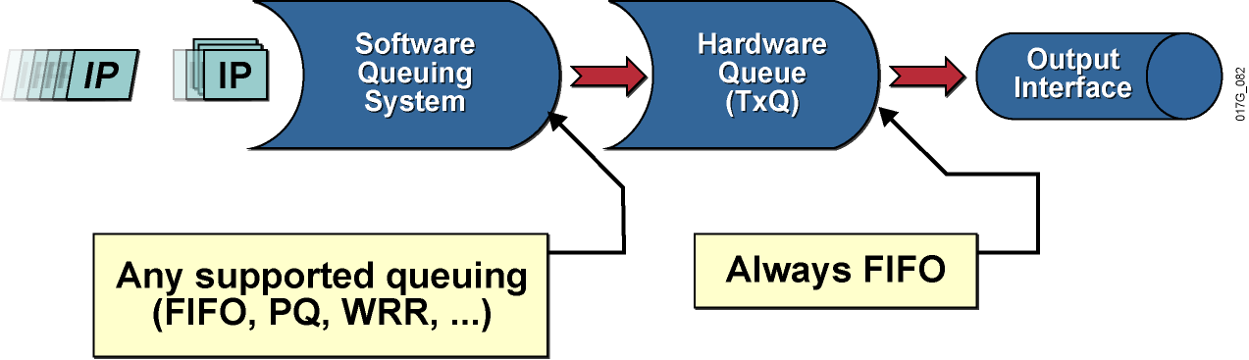
Architektúra frontového systému
Každé fyzické rozhranie má svoj hardvérový front
Nad každým fyzickým rozhraním môže pracovať systém softvérových frontov
Viacfrontové mechanizmy
Mechanizmy nad podrozhraniami (subinterfaces)
Notes:
Queuing on routers is necessary to accommodate bursts when the arrival rate of packets is greater than the departure rate, usually because of one of two reasons:
The input interface is faster than the output interface.
The output interface is receiving packets from multiple other interfaces.
Initial implementations of queuing used a single FIFO strategy. Better queuing mechanisms were introduced when special requirements required routers to differentiate among packets of different importance.
Queuing has two parts:
Hardware queue: Uses FIFO strategy, which is necessary for the interface drivers to transmit packets one by one. The hardware queue is sometimes referred to as the transmit queue.
Software queuing system: Schedules packets into the hardware queue based on the quality of service (QoS) requirements.

Slide 42
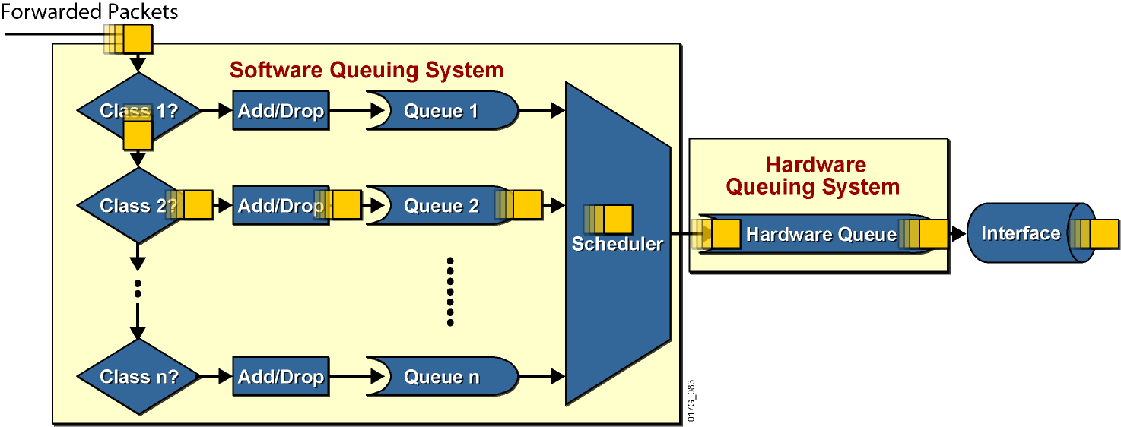
Architektúra frontového systému
Hardvérový front je vždy FIFO
Štruktúra softvérového frontového systému je konfigurovateľná podľa druhu smerovača, rozhraní a verzie IOSu
Notes:
Actions that must occur before transmitting a packet:
Most queuing mechanisms include classification of packets.
After a packet is classified, a router has to determine whether it can place the packet in the queue or drop the packet. Most queuing mechanisms will drop a packet only if the corresponding queue is full (tail drop). Some mechanisms use a more intelligent dropping scheme, such as weighted fair queuing (WFQ), or a random dropping scheme, such as weighted random early detection (WRED).
If the packet is allowed to be queued, it is put into the FIFO queue for that particular class.
Packets are then taken from the individual per-class queues and put into the hardware queue.

Slide 43
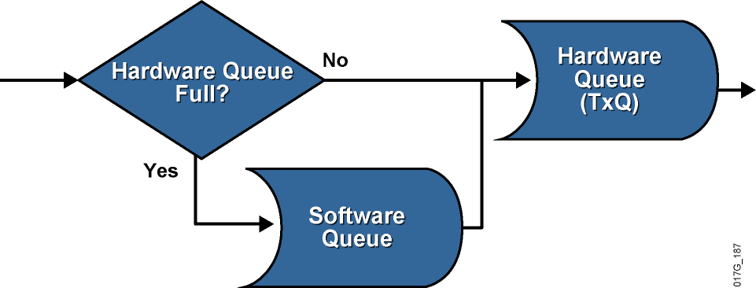
Softvérové fronty
Ak je hardvérový front rozhrania zaplnený, znamená to zahltenie rozhrania. Pakety, ktoré sa nezmestia do hardvérového frontu, sa ukladajú do softvérových frontov
Ak je v hardvérovom fronte rozhrania ešte voľné miesto, odosielaný paket sa doň vloží priamo – neprechádza softvérovým frontom
Ukladanie paketov do softvérového frontu nastáva iba vtedy, keď je hardvérový front plný
Notes:
The implementation of software queuing is optimized for periods when the interface is not congested. The software queuing system is bypassed whenever there is no packet in the software queue and there is room in the hardware queue.
The software queue activates only when data must wait to be placed into the hardware queue.
The double-queuing strategy (software and hardware queues) has its impacts on the results of overall queuing. Software queues serve a valuable purpose. If the hardware queue is too long, it will contain a large number of packets scheduled in the FIFO fashion. A long FIFO hardware queue most likely defeats the purpose of the QoS design requiring a certain complex software queuing system (for example, CQ).

Slide 44
Hardvérový front
Veľkosť hardvérového frontu na rozhraní je obmedzená, ale v rámci technických limitov konfigurovateľná
Smerovače určujú veľkosť hardvérového frontu rozhrania na základe konfigurovanej prenosovej kapacity (bandwidth)
Veľkosť hardvérového frontu je možné konfigurovať na rozhraní príkazom tx-ring-limit
Zmenšenie veľkosti hardérového frontu má dve základné výhody:
Skráti čas čakania v hardvérovom fronte
Urýchli aktiváciu softvérových frontových mechanizmov v IOSe
Nevhodné nastavenia však môžu spôsobiť neželané efekty:
Pridlhý hardvérový front spôsobí dlhé čakanie paketov a oneskorenú aktiváciu softvérových frontových disciplín
Prikrátky hardvérový front môže viesť k nadmernému počtu prerušení (IRQ), ktoré zaťažujú CPU a presúvajú úzke hrdlo (aj) naň
Notes:
The length of the transmit queue is dependant on the hardware, software, Layer 2 media, and queuing algorithm configured on the interface. The default transmit queue size is determined by Cisco IOS software, is based on the bandwidth of the media, and should be fine for most queuing implementations. Some platforms and QoS mechanisms automatically adjust the transmit queue size to an appropriate value.
Faster interfaces have longer hardware queues because they produce less delay. Slower interfaces have shorter hardware queues to prevent too much delay in the worst-case scenario in which the entire hardware queue is full of MTU-size packets.

Slide 45
Zistenie aktuálnej dĺžky hardvérového frontu
Príkaz show controllers vypisuje veľkosť hardvérového frontu zvoleného rozhrania
R1# show controllers serial 0/1/0
Interface Serial0/1/0
Hardware is GT96K
DCE V.11 (X.21), clock rate 384000
<...part of the output omitted...>
1 sdma_rx_reserr, 0 sdma_tx_reserr
0 rx_bogus_pkts, rx_bogus_flag FALSE
0 sdma_tx_ur_processed
tx_limited = 1(2), errata19 count1 - 0, count2 - 0
Receive Ring
rxr head (27)(0x075BD090), rxr tail (0)(0x075BCEE0)
rmd(75BCEE0): nbd 75BCEF0 cmd_sts 80800000 buf_sz 06000000 buf_ptr 75CB8E0
rmd(75BCEF0): nbd 75BCF00 cmd_sts 80800000 buf_sz 06000000 buf_ptr 75CCC00
<...rest of the output omitted...>
Notes:
The show controllers serial 0/1/0 command is used to see the length of the transmit queue.
The transmit queue length is shown as the tx_limited or tx_ring_limit or tx_ring statement and varies depending on the platform.
Example output
The output of the show command shows the length of the transmit queue.
In this example, the hardware queue length is defined by the tx_limited statement and equals two packets.

Slide 46
Zahltenie na softvérových rozhraniach
Podrozhrania a softvérové rozhrania (dialery, tunely, subinterface-y) nemajú svoj vlastný výstupný front
Tieto rozhrania trpia zahltením vtedy, keď sa zahltí výstupný hardvérový front na hlavnom hardvérovom rozhraní
Pojmy “TxQ” a “tx-ring” oba označujú hardvérový front a je ich možné voľne zamieňať
Notes:
Subinterfaces and software interfaces do not have their own separate transmit queues; they use the main transmit queue.
Software interface types include dialers, tunnels, and Frame Relay subinterfaces, and they will congest only when their main hardware interface transmit queue congests.
The transmit (tx‑ring) state is an indication of congestion of hardware interfaces caused by a congestion on the main hardware interface.

Slide 47
Čo sú to frontové disciplíny (Queuing)?
Frontové disciplíny (režimy, mechanizmy) sú mechanizmy na riadenie (zvládnutie) zahltenia na rozhraniach
Frontové disciplíny sú navrhnuté tak, aby obslúžili prechodné zahltenie rozhrania odložením nadbytočných paketov do vyrovnávacích pamätí (frontov), pokým nebude rozhranie opäť dostupné
Existujúce frontové disciplíny:
First-in, first-out (FIFO)
Priority queuing (PQ)
Round robin (RR)
Weighted round robin (WRR), Custom queueing (CQ)
Notes:
Queuing is a congestion-management mechanism that allows you to control congestion by determining the order in which identified packets leave an interface based on priorities assigned to those packets. Congestion management entails creating queues, assigning packets to those queues based on the classification of the packet, and scheduling the packets in a queue for transmission.
The default mechanism on most interfaces is the very simplistic first-in, first-out (FIFO) queue. Some traffic types, such as voice and video, have very demanding delay and jitter requirements, so more sophisticated queuing mechanisms must be configured on interfaces used by voice and video traffic.
Cisco IOS routers support several queuing methods to meet the varying bandwidth, jitter, and delay requirements of different applications.

Slide 48
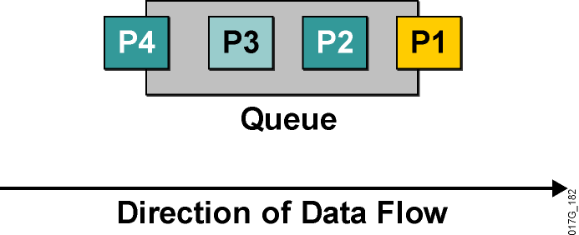
Frontový režim FIFO
Pakety sa odosielajú v poradí, v ktorom prišli
Definitívne najjednoduchší
Využíva jeden front
V iných mechanizmoch sa využíva niekoľko frontov, každý z nich je sám osebe FIFO
FIFO preto tvorí veľmi dôležitý základ všetkých ďalších mechanizmov
Notes:
In its simplest form, FIFO queuing—also known as first-come, first-served queuing—involves storing packets when the network is congested and forwarding them in order of arrival when the network is no longer congested.
FIFO embodies no concept of priority or classes of traffic and consequently makes no decision about packet priority. There is only one queue, and all packets are treated equally. Packets are placed into a single queue and transmitted in the order in which they arrive. Higher-priority packets are not transmitted faster than lower-priority packets.
When no other queuing strategies are configured, all interfaces except serial interfaces at E1 (2.048 Mbps) and below use FIFO by default. FIFO, which is the fastest method of queuing, is effective for links that have little delay and minimal congestion. If your link has very little congestion, FIFO queuing may be the only queuing you need to use.
All individual queues are, in fact, FIFO queues. Other queuing methods rely on FIFO as the underlying queuing mechanism for the discrete queues within more complex queuing strategies that support advanced functions such as prioritization.

Slide 49
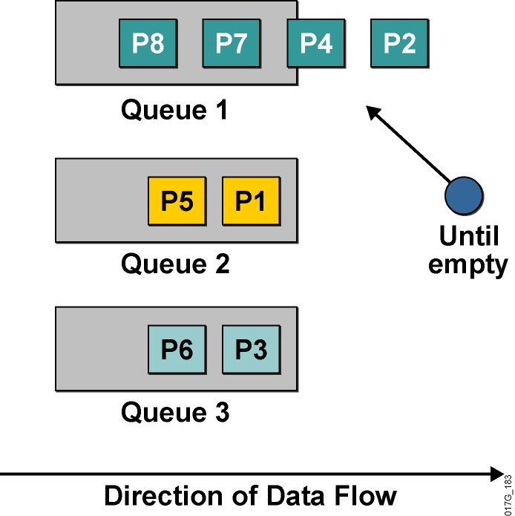
Frontový režim Priority Queuing
Používa viaceré fronty
Umožňuje stanoviť absolútne priority
Plánovač vždy vyberá pakety z frontu s najvyššou prioritou, v ktorom sa ešte nachádzajú čakajúce pakety
Front s najvyššou prioritou má garantovanú obsluhu
Hrozí riziko starvácie menej prioritných frontov
Je veľmi ťažké garantovať oneskorenie v menej prioritných frontoch
Notes:
Priority Queuing (PQ) allows network administrators to prioritize traffic in the network. A series of filters based on packet characteristics can be defined to cause the router to place traffic into a queue. The queue with the highest priority is serviced first until it is empty, then the lower queues are serviced in sequence.
During transmission, PQ gives priority queues absolute preferential treatment over low-priority queues; important traffic, given the highest priority, will always take precedence over less important traffic.
A priority list is a set of rules that describe how packets should be assigned to priority queues. A priority list might also describe a default priority or the queue size limits of the various priority queues.
Packets can be classified by the following:
Protocol type
Incoming interface
Packet size
Fragments
Access control list (ACL)
Keepalives sourced by the network server are always assigned to the high-priority queue; all other management traffic (such as Enhanced Interior Gateway Routing Protocol [EIGRP] updates) must be configured.
Although you can enable priority output queuing for any interface, it is best suited to low-bandwidth, congested serial interfaces.
When you choose to use PQ, consider that, because lower-priority traffic is often denied bandwidth in favor of higher-priority traffic, the use of PQ could, in the worst case, result in lower-priority traffic never being transmitted (the lower-priority traffic class is “starved”). To avoid this problem, you can use traffic shaping to rate-limit the higher-priority traffic.
PQ introduces extra overhead that is acceptable for slow interfaces but that may not be acceptable for higher-speed interfaces such as Ethernet. With PQ enabled, the system takes longer to switch packets because the packets are classified by the processed switch path. Furthermore, PQ uses a static configuration that does not adapt readily to changing network conditions.

Slide 50
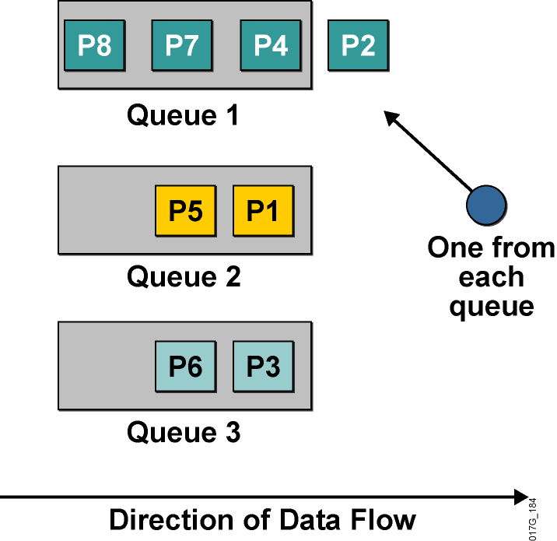
Frontový režim Round Robin Queuing
Využíva viaceré fronty
Nepodporuje priority
Plánovač v nekonečnom cykle prechádza frontami v pevnom poradí a z každého pri jednom prechode vyberie jeden paket na odoslanie
Každý front má garantované, že plánovač z neho do istého času odoberie paket
Podiel prenosového pásma pripadajúci na jeden front sa však nedá garantovať
Notes:
Round robin refers to an arrangement that involves choosing all elements in a group equally in some rational order, usually starting from the top to the bottom of a list and then starting again at the top of the list and so on. A simple way to think of round robin is that it is about “taking turns.” In round-robin queuing, one packet is taken from each queue and then the process repeats.
If all packets are the same size, all queues share the bandwidth equally. If packets being put into one queue are larger, that queue will receive a larger share of bandwidth.
No queue will “starve” with round-robin queuing because all queues receive an opportunity to dispatch a packet every round.
A limitation of round-robin queuing is the inability to prioritize traffic.

Slide 51
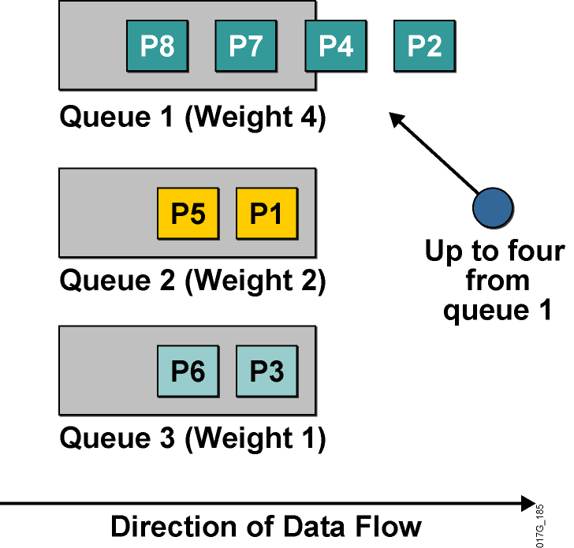
Frontový režim Weighted Round Robin Queuing
Vylepšenie obyčajného RRQ
Podporuje priority
Každému frontu prideľuje váhu
Fronty obsluhuje cyklicky ako RRQ, avšak z každého frontu vyberie počet paketov úmerný váhe frontu
Existujú implementácie, kde namiesto počtu paketov je definovaný objem dát, ktorý sa má z frontu odoslať
Táto implementácia sa volá Custom Queueing (CQ)
Notes:
The weighted round robin (WRR) algorithm provides prioritization capabilities for round-robin queuing as shown here.
In WRR, packets are accessed round-robin style, but queues can be given priorities called “weights.” For example, in a single round, four packets from a high-priority class might be dispatched, followed by two from a middle-priority class, and then one from a low-priority class.
Some implementations of the WRR algorithm provide prioritization by dispatching a configurable number of bytes each round rather than a number of packets. The Cisco custom queuing (CQ) mechanism is an example of this implementation.

Slide 52
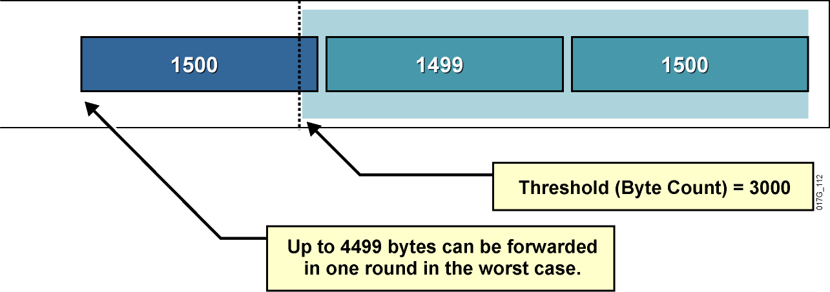
Problémy s Weighted Round Robin Queuing
Vo WRR (CQ) môže dochádzať k vychýleniu skutočných váh frontov
CQ dovoľuje v jednom prechode plánovača odoslať z frontu istý počet bajtov tým, že sa odošle hneď niekoľko paketov
Plánovač však môže odoslať paket aj vtedy, ak celkový počet odoslaných bajtov je väčší než povolená váha frontu
Notes:
This slide illustrates the worst-case scenario of the WRR algorithm, which uses the following parameters to implement WRR queuing on an interface:
The maximum transmission unit (MTU) of the interface is 1500 bytes.
The byte count to be sent for the queue in each round is 3000 bytes (twice the MTU).
The example shows that the router first sent two packets with a total size of 2999 bytes. Because this size is within the limit (3000), the router can send the next packet (which is MTU-sized, 1500 bytes). The result is that the queue received almost 50 percent more bandwidth in this round than it should have received.
This example shows one of the drawbacks of WRR queuing—it does not allocate bandwidth accurately.
The limit or weight of the queue is configured in bytes. The accuracy of WRR queuing depends on the weight (byte count) and the MTU. If the ratio between the byte count and the MTU is too small, WRR queuing will not allocate bandwidth accurately.
If the ratio between the byte count and the MTU is too large, WRR queuing will cause long delays.

Slide 53
Module 4: Implement the DiffServ QoS Model
Lesson 4.4: Configuring WFQ

Slide 54
Frontový režim Weighted Fair Queuing
Frontový režim, ktorý realizuje „férovú“ politiku, by sa mal správať podľa týchto kritérií:
Znižovať dobu odozvy pre interaktívne toky tým, že ich uprednostní pred ostatnými
Zabrániť veľkoobjemovým tokom monopolizáciu rozhrania
Ideálny férový algoritmus by mal cyklicky obsluhovať všetky fronty a z každého vybrať v jednom cykle jeden bit
Tento prístup je v paketových sieťach nepoužiteľný
Možno ho však nahradiť približným postupom:
Pre každý front si viesť evidenciu, koľko dát celkovo bude z neho odoslaných, ak z neho odošleme ďalší paket
Obsluhovať vždy ten front, z ktorého je vrátane nasledujúceho paketu celkovo odoslaných najmenej dát
Evidentne, treba sa starať o najzaostávajúcejší front
Notes:
WFQ is a dynamic scheduling method that provides fair bandwidth allocation to all network traffic. WFQ applies priority, or weights, to identified traffic to classify traffic into conversations and determine how much bandwidth each conversation is allowed relative to other conversations.
WFQ is a flow-based algorithm that simultaneously schedules interactive traffic to the front of a queue to reduce response time and fairly shares the remaining bandwidth among high-bandwidth flows. In other words, WFQ allows you to give low-volume traffic, such as Telnet sessions, priority over high-volume traffic, such as FTP sessions. WFQ gives concurrent file transfers balanced use of link capacity; that is, when multiple file transfers occur, the transfers are given comparable bandwidth.
WFQ solves problems inherent in the following queuing mechanisms:
FIFO queuing causes starvation, delay, and jitter.
Priority queuing (PQ) causes starvation of lower-priority classes and suffers from the FIFO problems within each of the four queues that it uses for prioritization.

Slide 55
Frontový režim Weighted Fair Queueing
Front 1, 200-bajtové pakety
Front 2, 150-bajtové pakety
Front 3, 100-bajtové pakety
Krok | Front 1 | Front 2 | Front 3
0 | 200 | 150 | 100
1 | 200 | 150 | 200
2 | 200 | 300 | 200
3 | 400 | 300 | 200
4 | 400 | 300 | 300
5 | 400 | 450 | 300
6 | 400 | 450 | 400
7 | 600 | 450 | 400
8 | 600 | 450 | 500
9 | 600 | 600 | 500
10 | 600 | 600 | 600

Slide 56
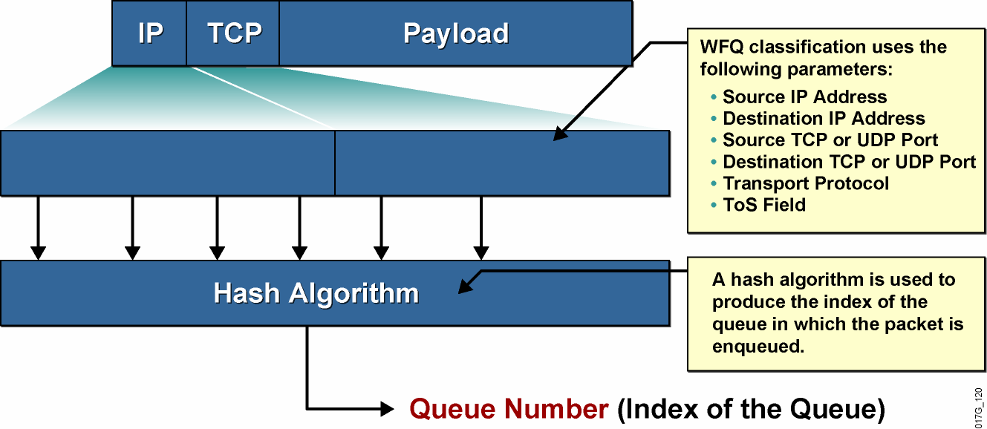
Konverzačné fronty vo WFQ
Source
IP
Address
Destination
IP
Address
Source
Port
Destination
Port
Protocol
ToS
Pakety rovnakého toku patria do rovnakého konverzačného frontu
Notes:
WFQ classification has to identify individual flows. This graphic shows how a flow is identified based on the following information taken from the IP header and the TCP or User Datagram Protocol (UDP) headers:
Source IP address
Destination IP address
Protocol number (identifying TCP or UDP)
Type of service field
Source TCP or UDP port number
Destination TCP or UDP port number
These parameters are usually fixed for a single flow, although there are some exceptions. For example, a quality of service (QoS) design can mark packets with different IP precedence bit values even if they belong to the same flow. You should avoid such marking when using WFQ.
The parameters are used as input for a hash algorithm that produces a fixed-length number that is used as the index of the queue.

Slide 57
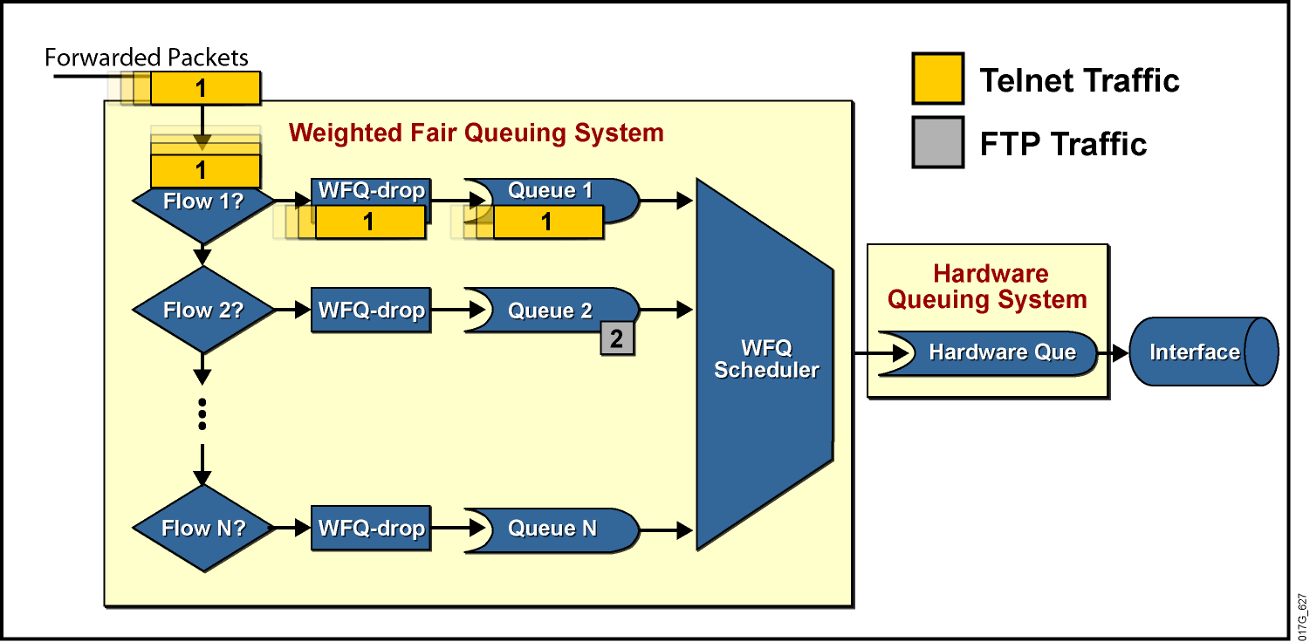
Architektúra frontov vo WFQ
Každý konverzačný front je typu FIFO
WFQ automaticky roztrieďuje jednotlivé konverzácie (toky) do frontov
Notes:
WFQ is a dynamic scheduling method that provides fair bandwidth allocation to all network traffic. WFQ applies weights to identified traffic, classifies traffic into flows, and determines how much bandwidth each flow is allowed, relative to other flows.
The WFQ method works as the default queuing mode on serial interfaces configured to run at or below E1 speeds (2.048 Mbps).
WFQ provides the solution for situations in which it is desirable to provide consistent response times to heavy and light network users alike, without adding excessive bandwidth. In addition, WFQ can manage duplex data flows, such as those between pairs of applications, and simplex data flows, such as voice or video.
Although WFQ automatically adapts to changing network traffic conditions, it does not offer the precise degree of control over bandwidth allocation that custom queuing (CQ) and class-based weighted fair queuing (CBWFQ) offer.
The significant limitation of WFQ is that it is not supported with tunneling and encryption because these features modify the packet content information required by WFQ for classification.

Slide 58
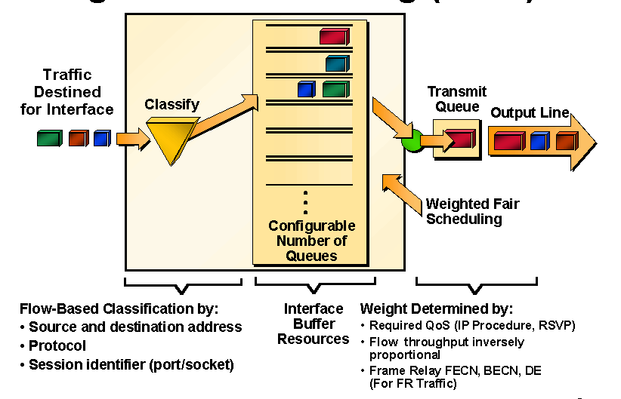
Prehľad činnosti WFQ
Notes:
For situations in which it is desirable to provide consistent response time to heavy and light network users alike without adding excessive bandwidth, the solution is Weighted Fair Queuing (WFQ). WFQ uses a flow-based queuing algorithm that does two things simultaneously:
It schedules interactive traffic to the front of the queue to reduce response time.
It fairly shares the remaining bandwidth among the various flows to prevent high-volume flows from monopolizing the outgoing interface.
The basis of WFQ is to have a dedicated queue for each flow without starvation, delay, or jitter within the queue. Furthermore, WFQ allows fair and accurate bandwidth allocation among all flows with minimum scheduling delay. WFQ makes use of the IP precedence bits as a weight when allocating bandwidth. Low-volume traffic streams, which comprise the majority of traffic, receive preferential service, transmitting their entire offered loads in a timely fashion. High-volume traffic streams share the remaining capacity proportionally between them.

Slide 59
Princíp činnosti WFQ
Vo WFQ každý paket v každom konverzačnom fronte dostáva tzv. sekvenčné číslo
Toto číslo vlastne vyjadruje celkový pomyselný objem dát prenesený týmto frontom vrátane daného paketu
Sekvenčné číslo sa pre paket vypočíta vzťahom
Sn+1 = Sn + váha * veľkosť paketu
kde Sn je poradové číslo predchádzajúceho paketu vo fronte a váha je číslo vypočítané zo vzťahu 32384/(IPPrecedence+1)
Váha umožňuje preferovať toky s vyššou hodnotou IP Precedence
Ak je daný konverzačný front prázdny, potom sa za Sn berie poradové číslo naposledy vloženého paketu do TxQ
Plánovač WFQ vyberá na odoslanie vždy paket s najnižším sekvenčným číslom
Obsluha je venovaná frontu, ktorý má doposiaľ najmenší podiel na celkovom objeme prevádzky odchádzajúcej daným rozhraním

Slide 60
Ako WFQ zahadzuje pakety
WFQ zahadzuje pakety na dvoch úrovniach:
Zahadzovanie pri dosiahnutí prahu Congestive Discard Threshold (počet paketov v danom konverzačnom fronte)
Agresívne zahadzovanie pri dosiahnutí limitu hold-queue (celkový počet paketov vo WFQ systéme)
WFQ vždy zahadzuje pakety najagresívnejšieho toku
Výnimka:
Paket umiestnený do prázdneho konverzačného frontu nikdy nebude zahodený
Notes:
The WFQ system has a hold queue that represents the queue depth, which means the number of packets that can be held in the queue. WFQ uses the following two parameters that affect the dropping of packets:
The congestive discard threshold (CDT) is used to start dropping packets of the most aggressive flow, even before the hold-queue limit is reached.
The hold-queue limit defines the maximum number of packets that can be held in the WFQ system at any time.
There are two exceptions to the WFQ insertion and drop policy:
If the WFQ system is above the CDT limit, the packet is still enqueued if the specific per‑flow queue is empty.
The dropping strategy is not directly influenced by IP precedence.
The length of queues (for scheduling purposes) is determined not by the sum of the size in bytes of all the packets but by the time it would take to transmit all the packets in the queue. The end result is that WFQ adapts to the number of active flows (queues) and allocates equal amounts of bandwidth to each flow (queue).
The side effect is that flows with small packets (usually interactive flows) get much better service because they do not need a lot of bandwidth. They need low-delay handling, however, which they get because small packets have a low finish time.

Slide 61
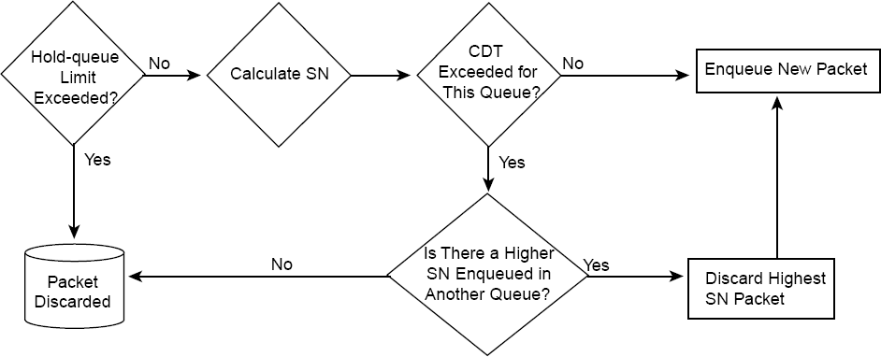
Ako WFQ zahadzuje pakety
Pojmy:
Hold-queue: limit na celkový počet paketov vo WFQ systéme
Congestive Discard Threshold: obmedzenie veľkosti individuálneho konverzačného frontu

Slide 62
Vlastnosti WFQ
WFQ používa predkonfigurovaný pevný počet konverzačných frontov
Na prevod vlastností toku na číslo frontu sa používa hashovacia funkcia
Systémové pakety a RSVP toky sú mapované na osobitné fronty
Je možné, že dva alebo viac tokov vďaka hash funkcii bude patriť do rovnakého konverzačného frontu
V takom prípade sa budú deliť o pridelené prostriedky
Dôležité: Počet nakonfigurovaných frontov by mal byť výrazne vyšší ako predpokladaný počet tokov
Notes:
WFQ uses a fixed number of queues. The hash function is used to assign a queue to a flow. There are eight additional queues for system packets and optionally up to 1000 queues for Resource Reservation Protocol (RSVP) flows. The number of dynamic queues that WFQ uses by default is based on the interface bandwidth.
With the default interface bandwidth, WFQ uses 256 dynamic queues. The number of queues can be configured in the range between 16 and 4096 (the number must be a power of 2).
If there are a large number of concurrent flows, it is likely that two flows could end up in the same queue. You should have several times as many queues as there are flows (on average). This design may not be possible in larger environments where concurrent flows number in the thousands.

Slide 63
Výhody a nevýhody WFQ
Výhody | Jednoduchá konfigurácia bez potreby klasifikácie Všetkým tokom garantuje isté pásmo Zahadzuje pakety najagresívnejších tokov Podporované na väčšine platforiem a IOS verzií
Nevýhody | Riziko, že viaceré toky pôjdu do rovnakého konverzačného frontu Neumožňuje externú kontrolu nad klasifikáciou Podporované na linkách najviac 2 Mb Neumožňuje poskytovať pevné garancie na pásmo
Notes:
The WFQ mechanism provides simple configuration (no manual classification is necessary) and guarantees throughput to all flows. It drops packets of the most aggressive flows. Because WFQ is a standard queuing mechanism, most platforms and most Cisco IOS versions support WFQ.
As good as WFQ is, it does have its drawbacks:
Multiple flows can end up in a single queue.
WFQ does not allow a network engineer to manually configure classification. Classification and scheduling are determined by the WFQ algorithm.
WFQ is supported only on links with a bandwidth less than or equal to 2 Mb.
WFQ cannot provide fixed guarantees to traffic flows.

Slide 64
Konfigurácia WFQ
router(config-if)#
fair-queue [cdt [dynamic-queues [reservable-queues]]]
cdt: Počet správ povolený v individuálnych konverzačných frontov. Číslo musí byť mocninou 2
dynamic-queues: Počet dynamických konverzačných frontov. Číslo je mocninou 2 v rozsahu 16, 32, 64, 128, 256, 512, 1024, 2048 a 4096; predvolená hodnota je 256
reservable-queues: Počet frontov pre RSVP rezervácie v rozsahu od 0 do 1000. Predvolená hodnota je 0
router(config-if)#
hold-queue max-limit out
Udáva maximálny počet paketov vo WFQ systéme
Predvolená hodnota je 1000
Notes:
Cisco routers automatically enable WFQ on all interfaces that have a default bandwidth of less than 2.048 Mbps. The fair-queue command enables WFQ on interfaces where it is not enabled by default or was previously disabled.

Slide 65
Monitoring WFQ
Router# show interface serial 1/0
Hardware is M4T
Internet address is 20.0.0.1/8
MTU 1500 bytes, BW 19 Kbit, DLY 20000 usec, rely 255/255, load 147/255
Encapsulation HDLC, crc 16, loopback not set
Keepalive set (10 sec)
Last input 00:00:00, output 00:00:00, output hang never
Last clearing of "show interface" counters never
Input queue: 0/75/0 (size/max/drops); Total output drops: 0
Queueing strategy: weighted fair
Output queue: 0/1000/64/0 (size/max total/threshold/drops)
Conversations 0/4/256 (active/max active/max total)
Reserved Conversations 0/0 (allocated/max allocated)
5 minute input rate 18000 bits/sec, 8 packets/sec
5 minute output rate 11000 bits/sec, 9 packets/sec
Notes:
The show interface command can be used to determine the queuing strategy. The output also displays summary statistics.
The sample output in this figure shows that there are currently no packets in the WFQ system. The system allows up to 1000 packets (hold-queue limit) with a CDT of 64. WFQ is using 256 queues. The maximum number of concurrent flows (conversations, or active queues) is four.

Slide 66
Monitoring WFQ
Router# show queue serial 1/0
Input queue: 0/75/0 (size/max/drops); Total output drops: 0
Queueing strategy: weighted fair
Output queue: 2/1000/64/0 (size/max total/threshold/drops)
Conversations 2/4/256 (active/max active/max total)
Reserved Conversations 0/0 (allocated/max allocated)
(depth/weight/discards/tail drops/interleaves) 1/4096/0/0/0
Conversation 124, linktype: ip, length: 580
source: 193.77.3.244, destination: 20.0.0.2, id: 0x0166, ttl: 254,
TOS: 0 prot: 6, source port 23, destination port 11033
(depth/weight/discards/tail drops/interleaves) 1/4096/0/0/0
Conversation 127, linktype: ip, length: 585
source: 193.77.4.111 destination: 40.0.0.2, id: 0x020D, ttl: 252,
TOS: 0 prot: 6, source port 23, destination port 11013
Notes:
The show queue command is used to display the contents of packets inside a queue for a particular interface, including flow (conversation) statistics:
Queue depth is the number of packets in the queue.
Weight is 4096 / (IP precedence + 1), or 32,384 / (IP precedence + 1), depending on the Cisco IOS version.
In the command output, discards are used to represent the number of drops that are due to the CDT limit.
In the command output, tail drops are used to represent the number of drops that are due to the hold-queue limit.

